Slide 1
Microsoft Copilot Studio

Slide 2



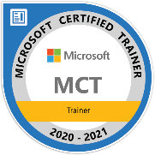
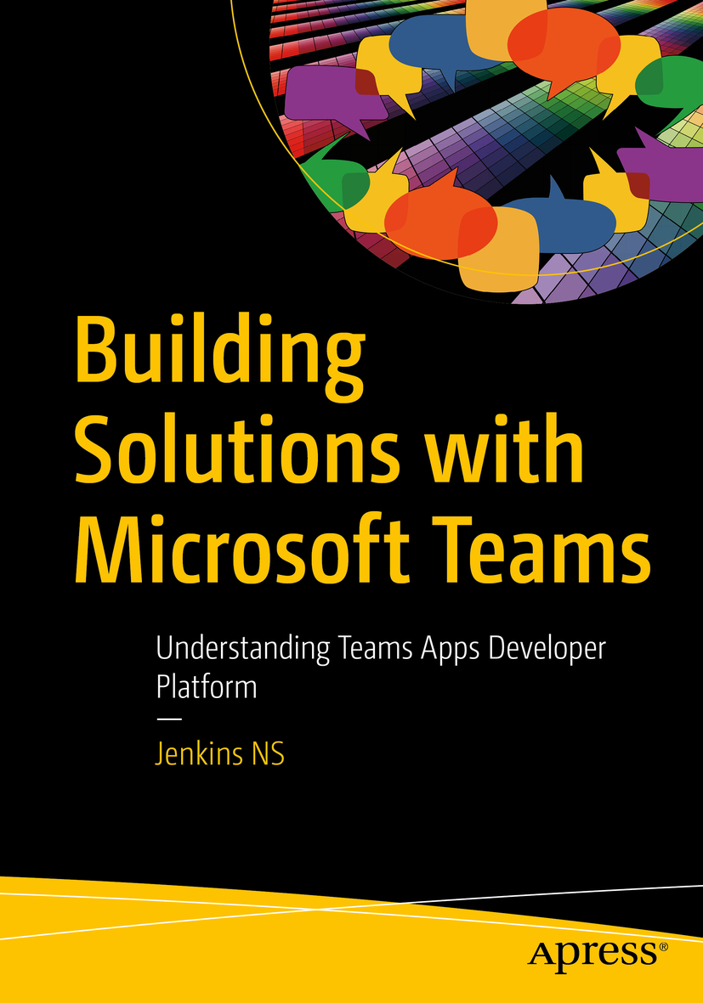








Jenkins NS
Modern Workplace Solution Architect | Consultant
Chennai, India
MVP | MCT | International Speaker | Author | Trainer
Microsoft Teams, Power Platform and SPFx Specialist
M365 Bangalore Organizer
aMS Ambassador
SharePoint-er Since 2005!
@jenkinsns
https://www.linkedin.com/in/jenkinsns/
https://www.youtube.com/user/jenkinsnss
Notes:
Hyperlinks in PowerPoint are active for the attendees if you use PowerPoint Live sharing in Teams.

Slide 3
Introductions (Participants)
What’s your name?
Which company/group do you represent?
What is your role?
What are your expectations from this training?
Notes:
Optional slide to ask participants to introduce themselves.

Slide 4
Agenda
Get started with Microsoft Copilot Studio
Manage topics in Microsoft Copilot Studio
Work with entities and variables in Microsoft Copilot Studio
Enhance Microsoft Copilot Studio bots.
Build & Publish Copilot with Channels
Extend your custom copilot
Add and manage knowledge for generative answers
Custom Development using Visual Studio Code
Custom Connector & Plugin
Copilot Security
Copilot Answers customization

Slide 5
Introduction to Conversational AI & Copilot Studio
Notes:
This deck is to be used with CSIAD (Refreshed) as an introduction to Conversational AI & Copilot Studio

Slide 6
Copilot Building Basics

Slide 7
Is a copilot just a chatbot?
Conversational AI
Chatbot Conversational experience using trained NLU models
Common to be text based
Data queried with APIs vs grounding
Prebuilt content and topics by makers
Embedded into sites, but siloed
Context holding
Copilot Evolution of chatbots as conversational assistants powered by large language models and generative AI to assist in your line of work.
Natural, multimodal interface
Grounding in multiple data sources
Generative content capabilities
Contextual interactions
Responsiveness and adaptability
Enables more than just text formats.
Works with your internal and external data sources
Generative AI powering Copilot building and response generation
Connected to the app experience it lays
Flexible to configure to context of experience.

Slide 8






A copilot for every Microsoft Cloud experience
Copilot for Dynamics 365
Copilot for Power Platform
Copilot to assist roles within each line of business applications.
Use natural language to accelerate the development of apps, automations and pages.
Copilot for Microsoft 365
Copilot for Security
Copilot assistant to accelerate productivity with Microsoft 365 apps and chat with your data
Receive tailored insights that empower your team to defend.
Copilot for Windows
Copilot for GitHub
Get answers and inspirations from across the web, supports creativity and collaboration, and helps you focus on the task
Increase developer productivity by helping you write code faster with less work.

Slide 9
Copilot stack
Rounded corner guide
AI safety and security
AI safety and security
Copilot Studio
Copilot Studio
Copilot Studio
Microsoft Copilot
Microsoft Copilot
Microsoft Copilot
Your Copilots
Your Copilots
Your Copilots
Microsoft apps
Microsoft apps
Microsoft apps
AI orchestration
AI orchestration
AI orchestration
Your data
Your data
Your data
Foundation models & AI toolchain
Foundation models & AI toolchain
Foundation models & AI toolchain
AI infrastructure
AI infrastructure
AI infrastructure
Microsoft Cloud

Slide 10

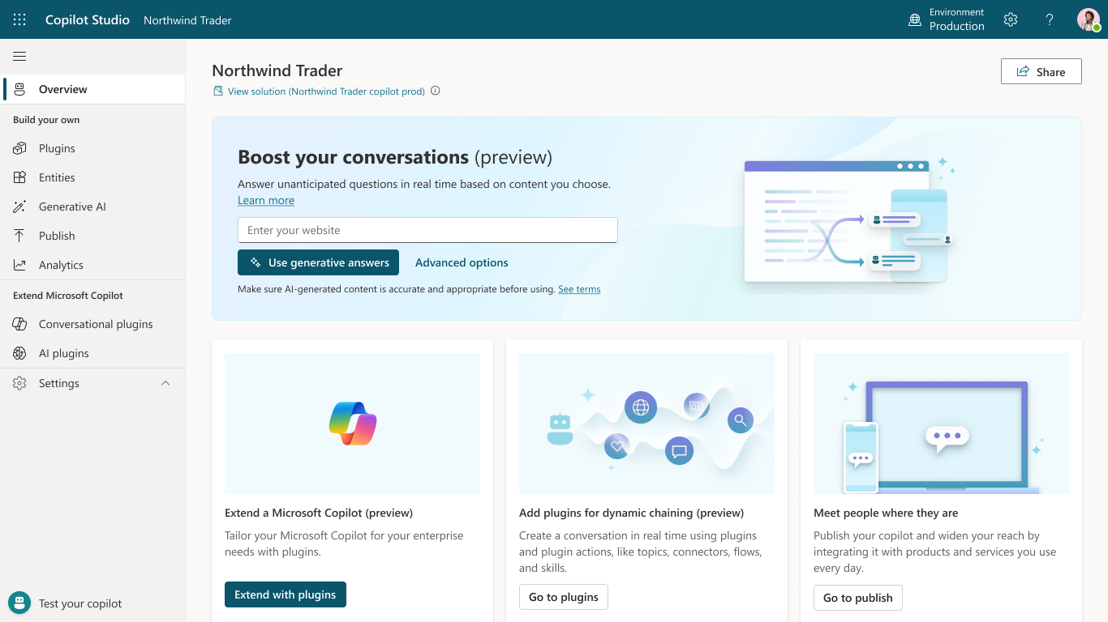
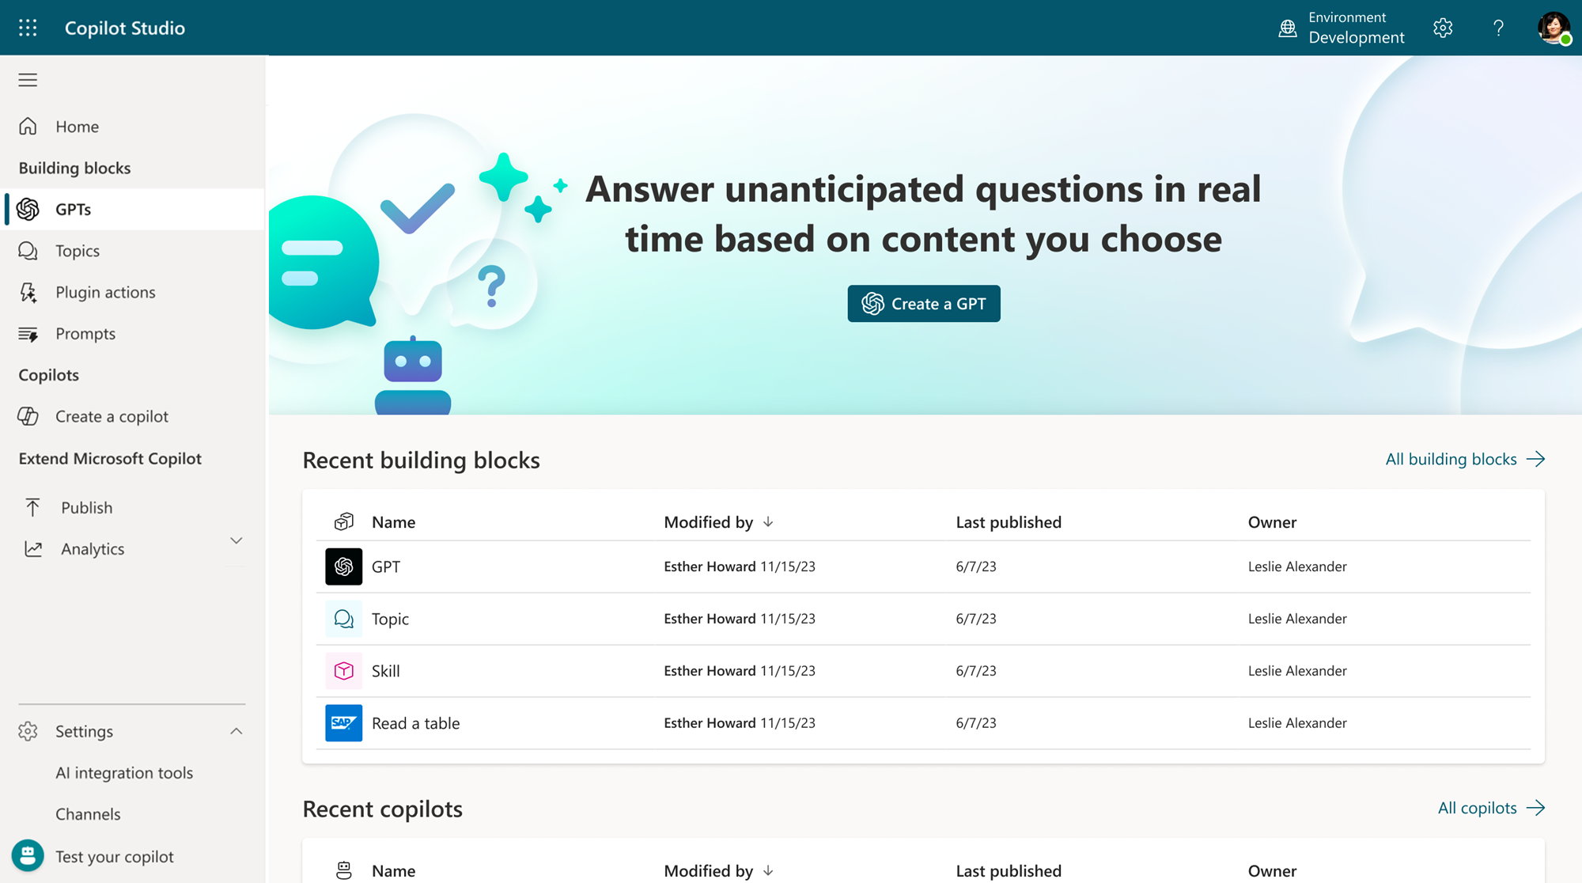
Microsoft Copilot Studio
Build your own copilot
Create and publish a custom copilot for your organization using the intuitive building experience enhanced with large language models and generative AI
Customize Microsoft Copilot Extend and customize 1st party Microsoft Copilots with your own enterprise scenarios. Copilot Studio will be included with the Microsoft 365 Copilot SKU.
Connected platform
Integrates and exposes various Microsoft’s conversational AI technology stacks - integrated with Azure AI Studio, Azure Cognitive Services, Azure Bot Framework, Power Platforms AI models and more
Manage copilot experiences
Governance and control features to monitor usage with full visibility of customizations, standalone copilots as well as who is building and customizing them.

Slide 11
Building Conversational Experiences can be broken up like this….
Conversational design
How to think about bots
How to design Conversational AI experiences
Key functional areas to consider
Language
Text & Speech
Generative AI & NLU
Authoring
Channel experiences

Slide 12
How to think about Copilots

Slide 13
Copilot rollout
User & Scenarios
Expectations
Reality
Notes:
The process of actually creating a bot isn’t smooth. If you’ve ever been on any project end-to-end, you know this – you’d think improvements build up over time to create smooth sailing all the way to the finish line. But that’s not the case, is it?
<CLICK>
Creating a bot is just like any other project. Things are going well, you’re building on what you’ve learned, you’re moving forward – and then you hit a snag and it all seems to fall apart. But when you keep going, when you work through those problems -- your finished project is even better than what you expected when you started out.
I’m not telling you this to dissuade you from designing a bot! There are a couple of reasons to bring this up: one, let’s normalize this! Everybody goes through this process when building a bot. And two, so that you don’t get discouraged when you’re building a bot – you know you can and should push through to that finish line.

Slide 14
It’s easy to know where a conversation begins and ends…
START
”Text Madison ‘what’s up?’”
Send text message to Madison
Success!
Notes:
The high-level understanding of what users are going do with a conversation system is the starting point. It’s where you, as the designer, begin to understand your user’s journey and their needs – and what your system can do to meet those needs.

Slide 15
The middle is the hard part…
START
”Text Madison ‘what’s up?’”
Is ”Madison” recognized?
No, no contacts named “Madison”
Yes, 1 contact named “Madison”
Yes, >1 contact named “Madison”
”Maddy”
Does this contact have a mobile number?
Which Madison?
User input required
“Butler”
“555-555-5555”
No number
Yes, 1 number
Yes, >1 number
User input required
“555-555-5555”
“From Indiana”
“Email them instead”
User input required
User input required
“Ugh, I don’t know, cancel”
Success!
Send text message to Madison
“Um the first one”
Notes:
…but you also need to delve into the logistics behind the users’ needs and wants. What does it actually mean for your system to be able to answer this particular question or complete this particular task?
What decisions are being made “behind the scenes”? What other platforms might you need to integrate with? What might you need access to? What do your users think is going on? What assumptions are they making when they trigger this? Is your design going to align with their mental model of what’s going on?
And you also need to zoom out, and consider: how can I design this so it’s easy for the user?

Slide 16
Adding Generative AI
Notes:
The high-level understanding of what users are going do with a conversation system is the starting point. It’s where you, as the designer, begin to understand your user’s journey and their needs – and what your system can do to meet those needs.

Slide 17



Generative AI is changing building
Traditional (e.g. Azure)
Create Azure tenant and infra
Annotate thousands of utterances and conversations to build a custom NL model
Create topics in code using Visual Studio and BF SDK
Host Azure Bot Service and instantiate the appropriate channel
Deploy your copilot to the service
Build your own custom analytics pipeline
Every time your knowledge content changes (e.g. different hours) go and update the copilot in code
Manually authored topics
Anticipate and build a manual topic for each possible user question
Then keep these topics up to date as your content changes
BUSINESS CRITICALITY
Missed opportunity
Time spent hand-building topics
Conversations missed or escalated
TOPICS BUILT

Slide 18

Generative AI is changing building
Copilot Studio with Generative AI
Full E2E SaaS – no infra to host or manage
No explicit NL training or custom model required, comes with powerful large language model
Point to a knowledge sources and have a useful bot in minutes with Generative AI
Customize your copilot with business-critical topics using easy to use graphical interface and 1000s of pre-built connectors, or call custom APIs
Developers, low-code users can collaborate inside the same canvas with graphical multi-authoring and code side-by-side
Publish to the channel of your choice in minutes with a few clicks
Manually authored topics
Manually author business-critical topics quickly with Copilot Studio
BUSINESS CRITICALITY
Expose your knowledge sources and APIs and generative AI handles the rest Vast coverage of the long tail, and as content changes, copilot answers change as well
Custom build topics + help from Copilot
Topics handled by Generative Answers and Actions
TOPICS BUILT

Slide 19
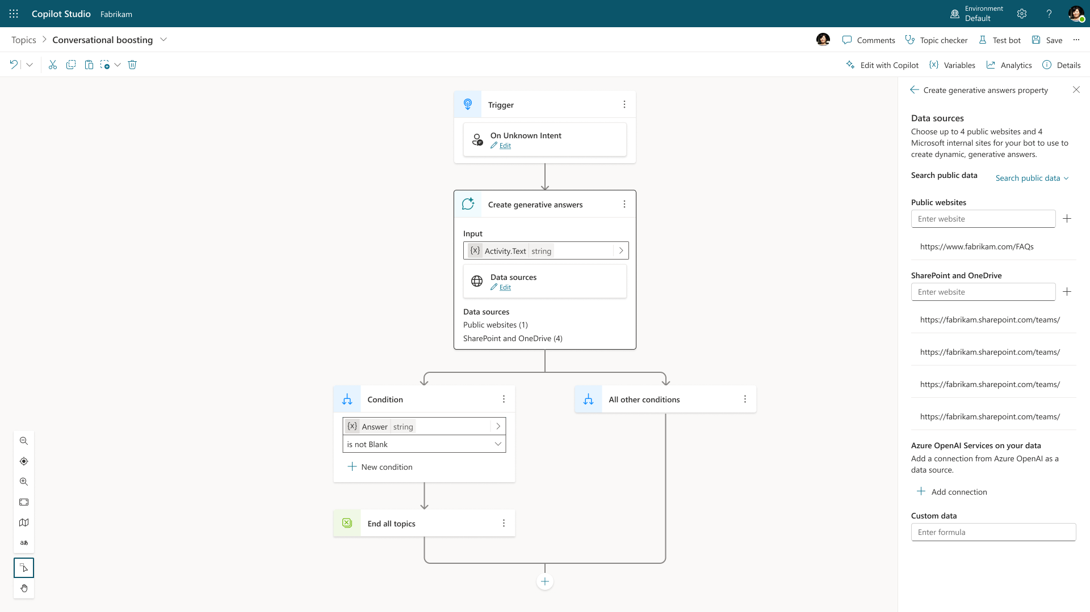
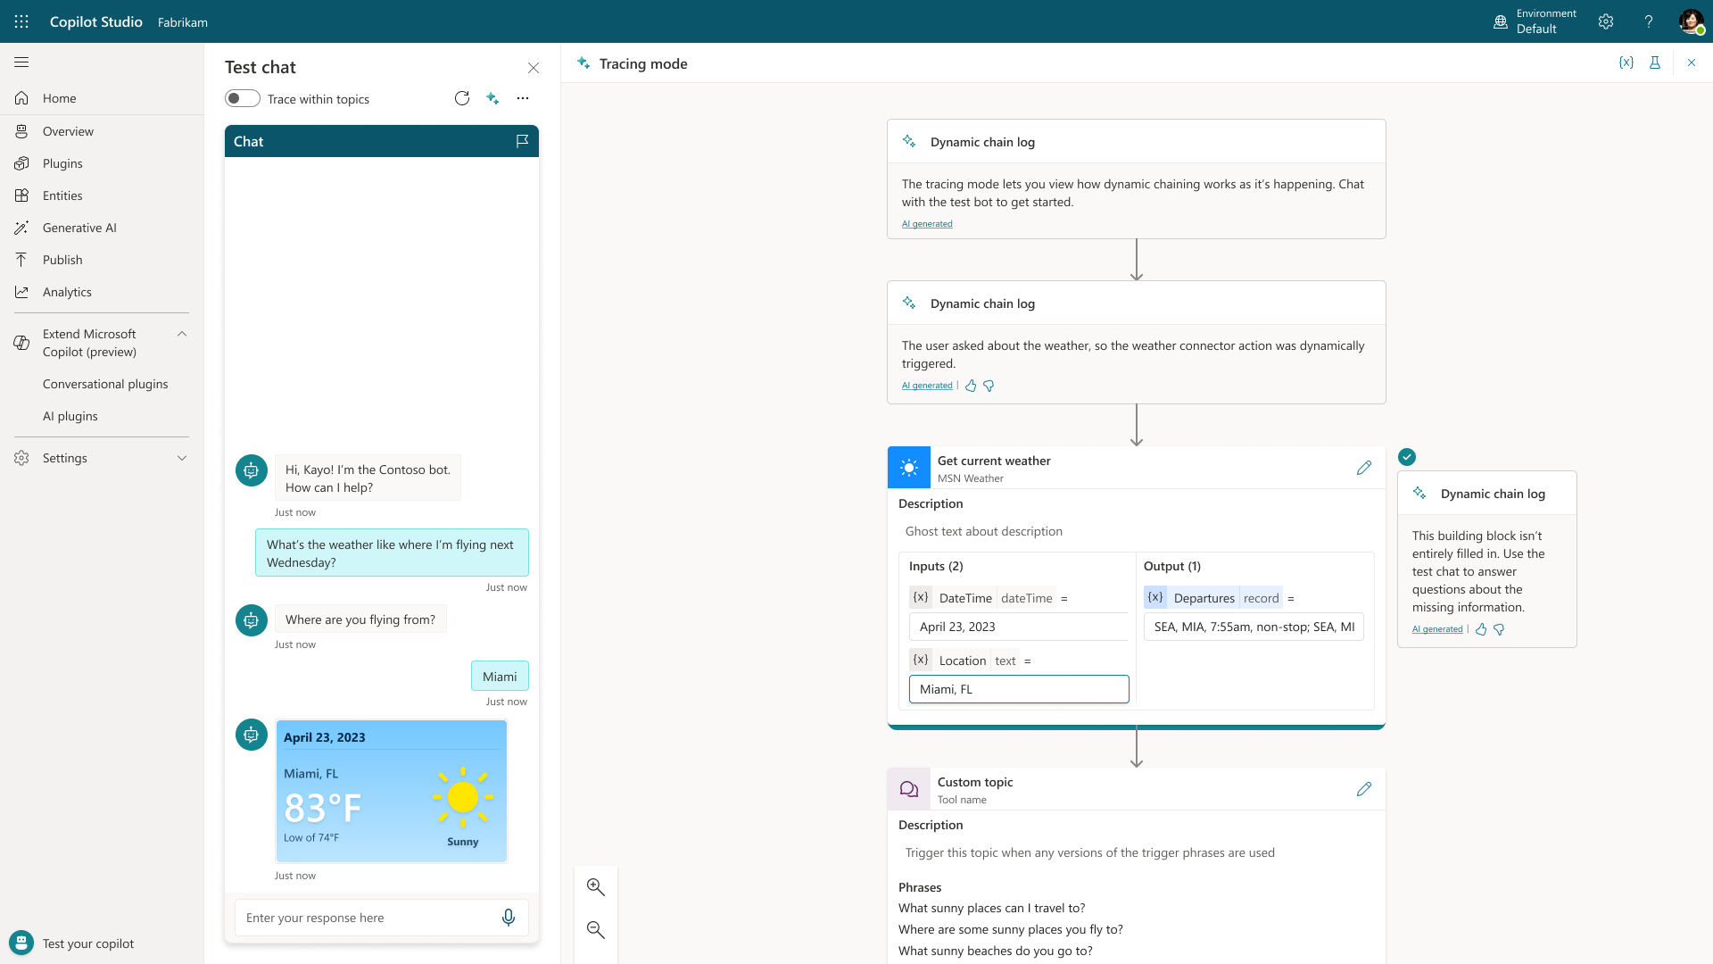
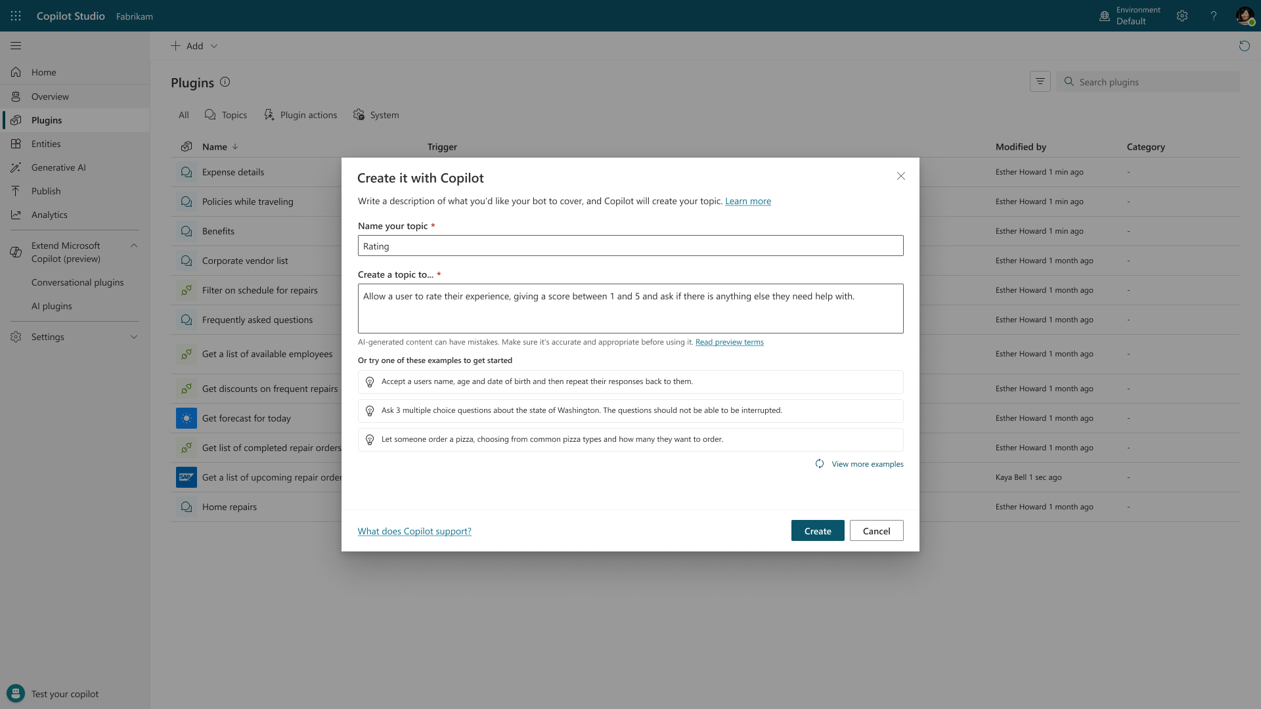
Generative AI in Copilot Studio Powered by Azure OpenAI Service
TO ANSWER
TO ACT
TO BUILD
Generative Answers Dynamically generate multi-turn answers based off an organization's content in real-time.
Generative Actions Generate dialog and take action through dynamically chaining existing building blocks and plugins.
Generative Building The Copilot assistant helps build, design and modify copilot topics through natural language.
Public Preview
Public Preview
Generally Available

Slide 20
Generative Answers
Out of the box, your copilot answers questions based on the content your organization has already invested in
Always up to date, your copilot uses your latest published content for each request; no more maintaining info in two places
Enable multi-turn chat over your own internal and external knowledge sources, files and sites with generative answers
Supports content on the web, SharePoint, Azure Open AI on your data, and direct file upload and custom calls to backends
You can even pull data from an API or other backend system and enable generative chat over it
Try now at aka.ms/copilotstudio
Generally Available

Slide 21
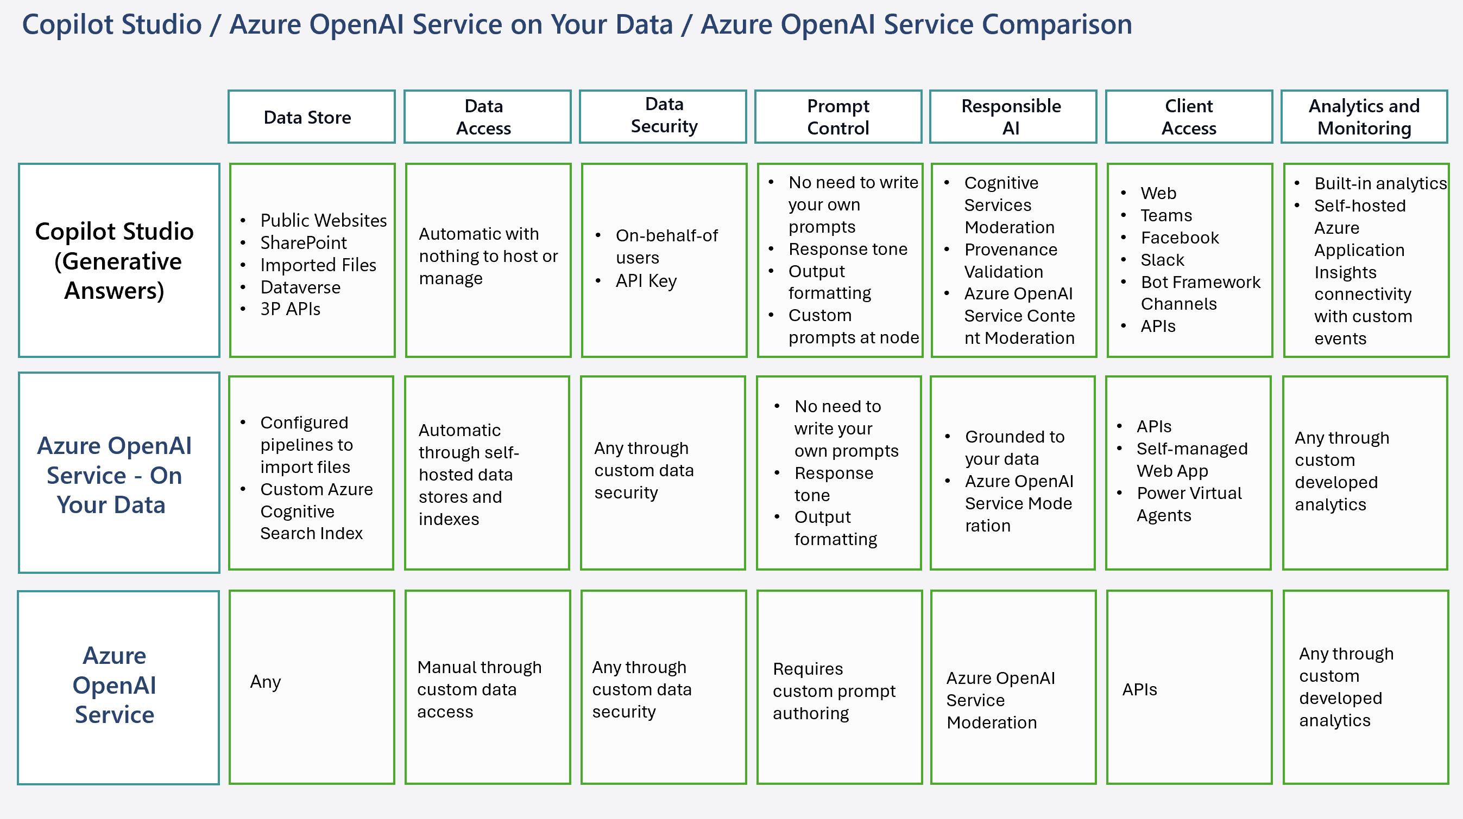
Considerations & Discovery with Generative AI

Slide 22
Questions to help you get started
What does it mean for your bot to truly answer their questions?
What are some unexpected responses your bot may encounter?
What data might you need access to and need to integrate with various systems to do so?
What assumptions do your users have when they engage with your bot?
What context do your users have when talking with your bot, and does this solution fit that mental model?
How can you design a bot that is easy for your users to navigate and find the answers they are looking for?
Notes:
Now, I’ve run into the question of what to call users a few times before. So I want to clarify that the way I use “user” throughout this presentation – and in general – is a person who uses a product or a service.
“user” might not be the best word for the people you’re designing for. So you can and should pick a different word that works better for you and your community, if you’re continuously running into this problem as you create your experience.
As you come up with a new word to describe your design audience, though, you should some things in mind… <CLICK>
Keep the human being at the front. You’re creating a human-centric experience; make sure you begin as you mean to go on. <CLICK>
Don’t forget that this is usually going to be a word that you use with your design team, your engineers, your PMs, your stakeholders… but not necessarily with the people who are using the product or service itself. That’s not a hard-and-fast rule of course, but you don’t have to use the same terminology internally that you do in your user-facing copy. <CLICK>
And, of course, consider how inclusive you’re being. What is the most inclusive word for the group of people you’re designing for? If you’re working on, say, a healthcare experience, and you want to use “member” instead of “user,” that’s fine. But are you then excluding the sales or sign-up experience for new members, those people who aren’t yet a member but might be? What about previous members, who might not be a member anymore but may still need access to their medical records or billpay, or may still use your product somehow? <mini pause> if you’re building an internal experience for employees, will all employees be using this experience? And will they be using it regularly, or will they just be using it to, say, check their how much vacation time they have, and so really your set of employees is actually a set of “employees who are actively searching for information about their paid time off balance”? Or maybe this is something like an ethics reporting page, where employees can use this experience if need to but won’t use it in their daily work life. So if all employees have the option of using this experience, when they need or want to, is your design really aimed at ”employees who are using this experience” and not “all employees”? <mini pause>
What I’m trying to drive home is, the specificity of your words MATTER. So, you’ll hear me use the term “user” throughout, but I really want to make sure to highlight the intentionality of this choice.

Slide 23
Building Conversational Experiences

Slide 24
Who is a “user”?
Things to keep in mind
Who is your user?
What types of conversations will your bot be having with this audience?
And lastly where will these conversations take place?
Don’t forget who you’re designing for
User
A person who uses a product or service.
Notes:
Now, I’ve run into the question of what to call users a few times before. So I want to clarify that the way I use “user” throughout this presentation – and in general – is a person who uses a product or a service.
Some considerations might be that “user” might not be the best word for the people you’re designing for. So you can and should pick a different word that works better for you and your community, if you’re continuously running into this problem as you create your experience.
As you come up with a new word to describe your design audience, though, you should some things in mind… <CLICK>
Keep the human being at the front. You’re creating a human-centric experience; make sure you begin as you mean to go on. <CLICK>
Don’t forget that this is usually going to be a word that you use with your design team, your engineers, your PMs, your stakeholders… but not necessarily with the people who are using the product or service itself. That’s not a hard-and-fast rule of course, but you don’t have to use the same terminology internally that you do in your user-facing copy. <CLICK>
And, of course, consider how inclusive you’re being. What is the most inclusive word for the group of people you’re designing for? If you’re working on, say, a healthcare experience, and you want to use “member” instead of “user,” that’s fine. But are you then excluding the sales or sign-up experience for new members, those people who aren’t yet a member but might be? What about previous members, who might not be a member anymore but may still need access to their medical records or billpay, or may still use your product somehow? <mini pause> if you’re building an internal experience for employees, will all employees be using this experience? And will they be using it regularly, or will they just be using it to, say, check their how much vacation time they have, and so really your set of employees is actually a set of “employees who are actively searching for information about their paid time off balance”? Or maybe this is something like an ethics reporting page, where employees can use this experience if need to but won’t use it in their daily work life. So if all employees have the option of using this experience, when they need or want to, is your design really aimed at ”employees who are using this experience” and not “all employees”? <mini pause>
What I’m trying to drive home is, the specificity of your words MATTER. So, you’ll hear me use the term “user” throughout, but I really want to make sure to highlight the intentionality of this choice.

Slide 25

Users talking to bots
They know they’re not talking to a person.
They know it’s not reciprocal.
But their emotional response is very real.
Notes:
Because people absolutely connect with their devices. Even when they know they’re not talking to a person. Even when they know their device isn’t experiencing emotion. People aren’t dumb, but the stimulus of interaction, the stimulus of conversation still triggers very real, and very authentic emotional responses.

Slide 26
Useful Conversational Experiences
Pick a scenario that will delight and will be requested repeatedly: is the scenario conversational?
Does the bot easily solve the user's problem with minimal back and forth turns?
Is the bot discoverable and easy to invoke?
Mimic human to human conversation in your design of the transcript
Prototype to uncover what is working
Create a test plan
Notes:
Design perspective… you got this!
-Scenario thinking: why would users ask these questions to your agent. Do you have data that shows main potential interactions
-Who is your persona spectrum: the breadth of your reach. Are you truly helping them, or just asking them too many questions that will irritate them
-IF you have a great designed bot but no user can find it… be where your users are
-Chat and voice design: there are different as conversations are more verbose? You can remember less…
-Prototype a POC before you start the actual development
-Test with people outside of you group of creators.

Slide 27
Focus on user-centric language
Rewrite I to you
Give actionable, unambiguous prompts
Be clear and concise
Acknowledge and affirm
Simple, inclusive and human-centric language
Notes:
“Focus on the user” is about the intentionality of what you can do within the design itself to make the user feel like they’re truly a part of the conversation.
Writing in the second person helps the user focus on themself, instead of on abstracts. This isn’t just a question of pivoting prompts from “How can I help?” to “What are you looking for?” – it’s also things like “It’s 85 degrees in Miami” when the user asks for the weather instead of just saying “It’s 85 degrees.” (For anybody who doesn’t use Fahrenheit – that’s about 29 Celsius! Don’t worry, Miami isn’t that hot.)
We want to guide the user through or towards a desired behaviour, using unambiguous prompts. Clarity is crucial! So don’t let the user flounder, wondering what they should be doing. And…
Be a minimalist – what’s the least amount of information that the user requires to move on and still be informed? Give them that.
Give the user confirmation. Don’t go overboard and fill up a conversation by repeating everything the user says back to them, but for anything transactional or anything actionable, make sure the user understands whether or not something has been completed successfully. So – for example, if your user has asked to be connected to a live human, make sure they know whether or not a human is being connected into the chat. If you’ve got a form fill within a bot, don’t repeat back all the information in it! But maybe you can tell the user whether or not that information was sent off successfully. Be reasonable, don’t go overboard – because remember, minimalism! – but your user shouldn’t be confused about whether something was successful or not.
Lastly, consider what you would want if you were the user. Do you have all the necessary information? Do you have too much information? This does not replace usability testing, of course, since often we as makers are subject matter experts and therefore tend to either over- or underestimate other people’s knowledge in a particular field, but it’s a good exercise to step back and consider your bot from another point of view.
Spotlighting the user in your design like this will help the user maintain a positive relationship with the bot.

Slide 28
Best practices
Understand your user
Keep it simple and clear
Be inclusive
Personality is important
Use the right tools
Notes:
At Microsoft, we’ve rolled our best practices up to five pretty simple, comprehensive best practices for intentional design:
Understand your user;
focus on the user;
keep it simple, keep it clear;
use the right tools; and
be inclusive.

Slide 29
Essence of inclusive design
Design better bots
Learn from real people
Construct more natural conversations
Put users first
Notes:
At its core, inclusive design is about not just about making sure everyone has a chair at the table – it’s about making sure everyone can participate in the discussion.
---

Slide 30
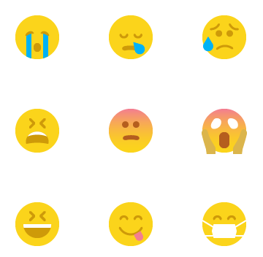





Bot brand & personality
Nicky
What’s my name?
How do I look and react?
How should I sound?
When should I ask for help?
Think about your name and how it reflects your brand and the type of bot you are designing.
Tone of voice is the primary way you will inject your brand into a bot.
Just like a mobile app your assistant icon is really important.
The interactive changing state of your bot is highly recommended: listening, waiting, responding etc.
No matter how smart your bot is, there will be cases where you still need to let a human take control of the conversation.

Slide 31
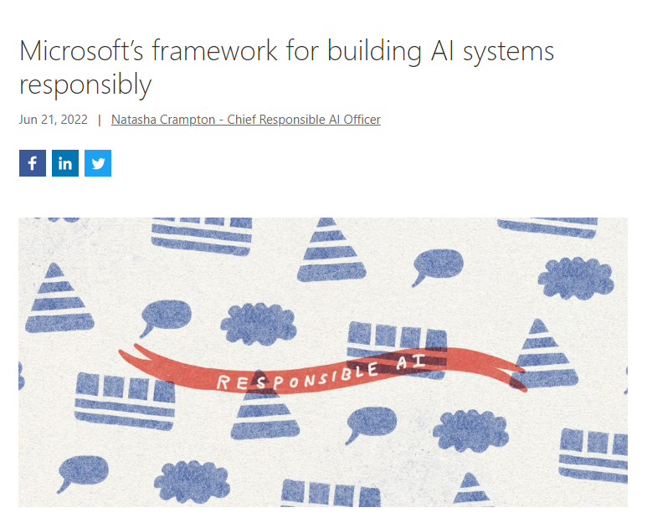
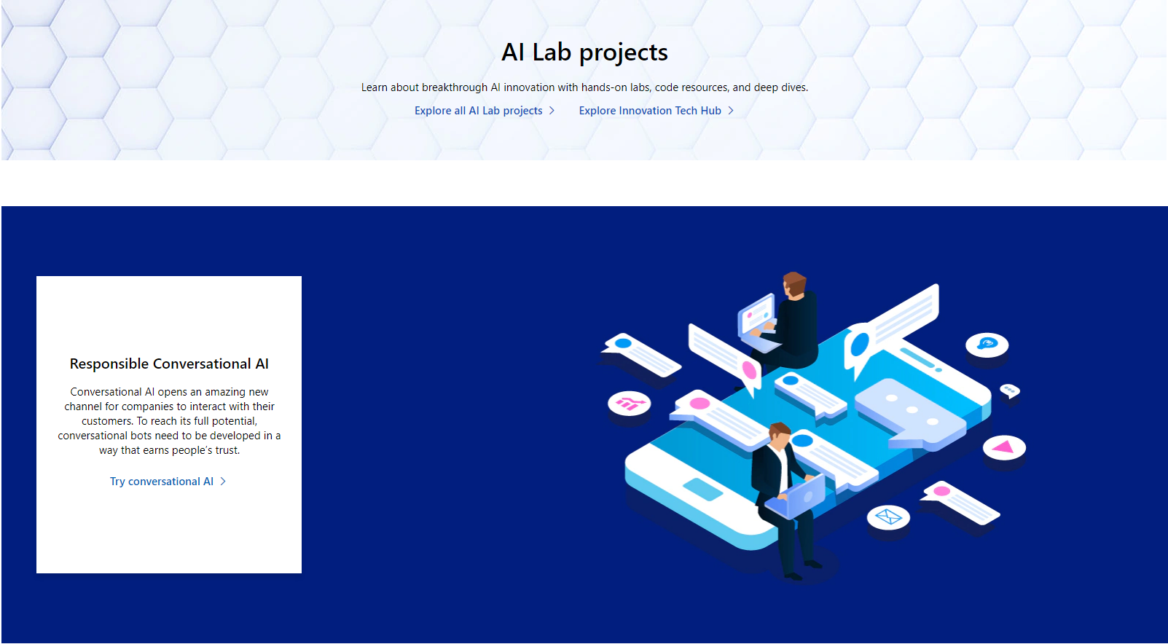
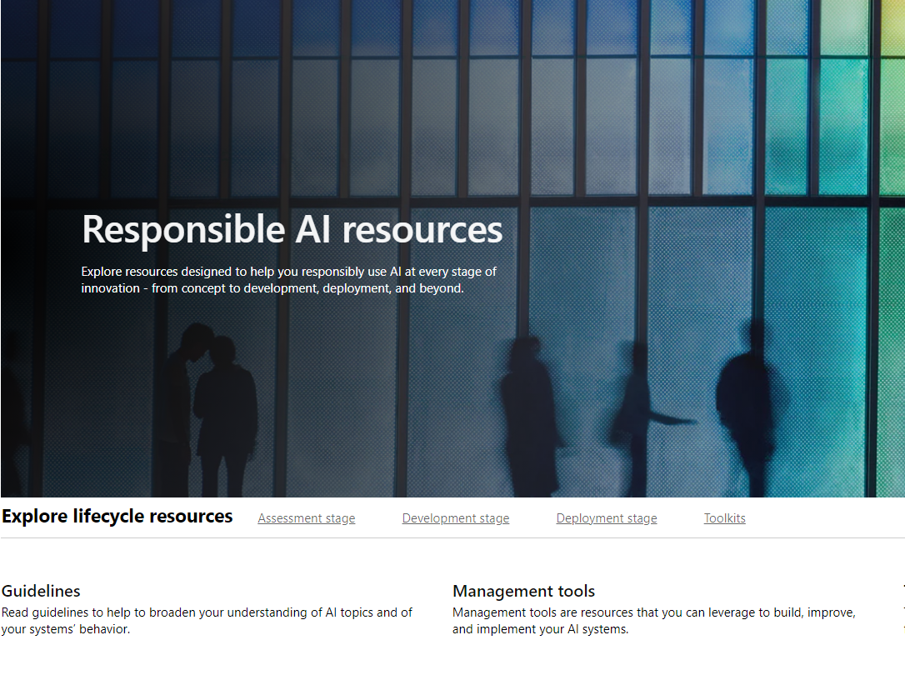
Ethical considerations
Microsoft's framework for building AI systems responsibly
Responsible Conversational AI – Microsoft AI Lab
Responsible AI Resources – Microsoft AI
aka.ms/ResponsibleConvAI
aka.ms/Responsible-AI-Resources
aka.ms/MSFTAIFramework
Notes:
It’s really important to note that there are also ethical considerations here. Microsoft has made a commitment to build better, more trustworthy AI, and bot-building is a part of that.
Responsible AI is a huge topic, and it could be its own session. But I do want to leave you with resources to explore it later on, so here are some of the links you can and should go to on your own –
A press release from Microsoft’s Chief Responsible AI Officer, Natalie Crampton, which also includes a link to Microsoft’s Responsible AI Standards;
Microsoft’s Responsible AI homepage, with guidelines, research, and information; and
The resources page from the Responsible AI page, where you’ll find technology tools, management tools, and guidelines to help you on your journey to building bots more conscientiously.
You can access these resources using the shorthand “aka dot ms” links on the screen.
AKA.ms slash MSFT ai framework
AKA.ms slash responsible conv ai, and
AKA.ms slash responsible dash ai dash resources

Slide 32
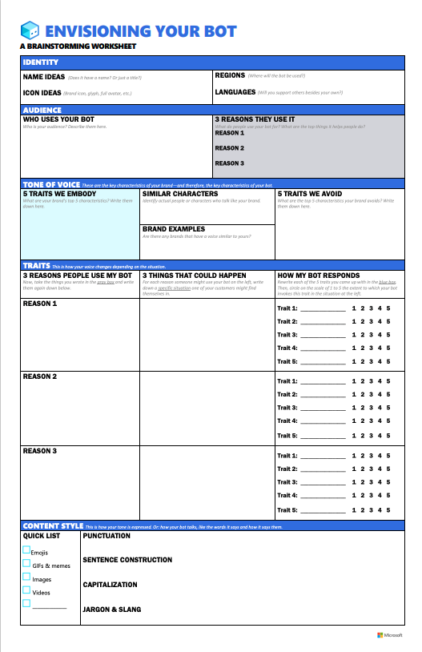
Brainstorm worksheet
https://aka.ms/ConversationalAIWorksheet
Conversational user experience in the Bot Framework SDK - Bot Service | Microsoft Docs
Notes:
The CUX guide
The CUX guide, contains guidance on designing a bot. This guidance aligns with best practices and capitalizes on lessons learned. The authors and designers of this guidance are drawing from combined decades of experience building and deploying conversational UX for a variety of bots, virtual agents, and other conversational experience projects, including Bot Framework Templates, Microsoft Virtual Assistant, Personality Chat, and others.
Tip
Download the CUX Guide Microsoft.pdf
This CUX guide is divided loosely into a few different sections. The CUX guide includes:
An introduction to CUX, ethics and inclusive design.
A brainstorming worksheet and guidelines for planning and designing.
Practical development tips for building CUX experiences.
Read the topics in order, or jump to the area that addresses your needs.
Note
A note on terminology: the guide explores several kinds of conversational experiences, including bots, virtual agents, and digital assistants. We use those terms relatively interchangeably because the principles of CUX design in this guidance apply to all, but we recognize there are distinctions in the industry. Our intention is to offer guidance that will help with most text-based conversational experiences, regardless of their intent.

Slide 33
Align the bot with your organization's goals
Handling repetitive information requests when a skilled human agent is not required
Reducing the time, it takes to get answers to end users
Lowering support call volume, while also handling high call volume
Improving support KPIs
Using a bot as part of the brand strategy

Slide 34
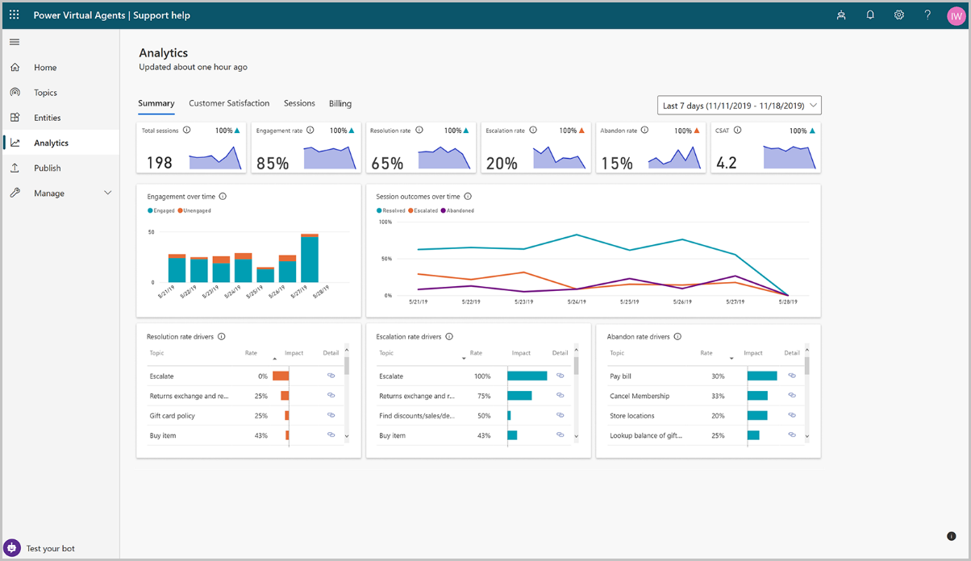
Getting Started Right
Identify the right requirements
Start small and scale up
Track Analytics for ongoing improvements
Utilize the Copilot Studio implementation guide:
https://aka.ms/copilotimplemetationguide

Slide 35
Build Engaging Bots
FAQ vs Business Integrated
Leverage Power Automate Connectors
Value beyond Form Filling
High Deflection Rate
Notes:
FAQ Bot engagement can decline over time compared with a bot that is integrated with business processes

Slide 36
Microsoft Copilot Studio

Slide 37
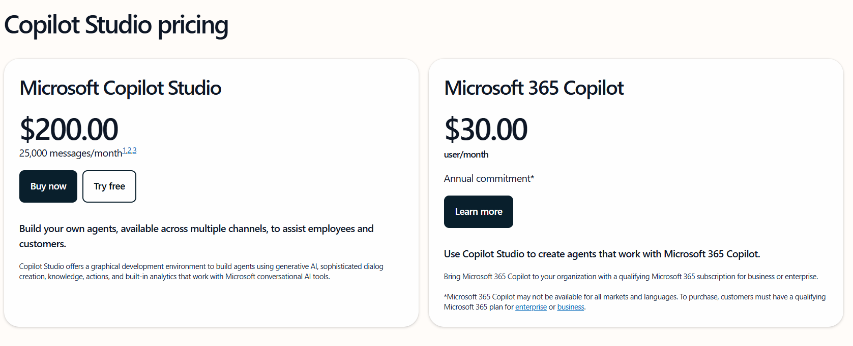
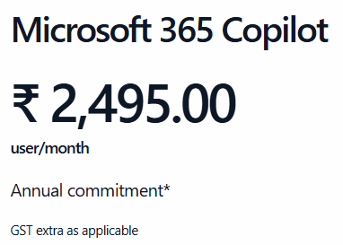
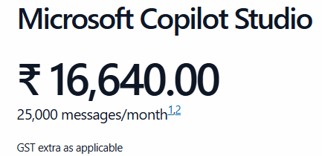
Licensing
https://www.microsoft.com/en-us/microsoft-copilot/microsoft-copilot-studio#Pricing
https://www.microsoft.com/en-in/microsoft-copilot/microsoft-copilot-studio#Pricing

Slide 38
Licensing …
[1]Licenses are capacity based, and additional messages can be purchased. A billable message is a request or message sent to the copilot/bot triggering an action and/or response. Once your paid subscription begins, cancellation policies vary based on your status as a new customer and your Microsoft product and domain selections. Learn more. Cancel your Microsoft 365 subscription any time by going to the Microsoft 365 admin center. When a subscription is canceled, all associated data will be deleted. Learn more about data retention, deletion, and destruction in Microsoft 365. Prices shown are for marketing purposes only and may not reflect the actual list price due to currency, country, and regional variant factors. Your actual price will be reflected in the checkout.
[2]Message consumption rates: 1) Regular (non-generative AI) = 1 message; and 2) Generative AI (answers over your data) = 2 messages. Customers can use a mix of regular and generative AI messages with the capacity.
[3]Microsoft Copilot Studio offers select capabilities for extensibility of Microsoft 365 Copilot within the $30 user license. This is separate to the standalone license.

Slide 39
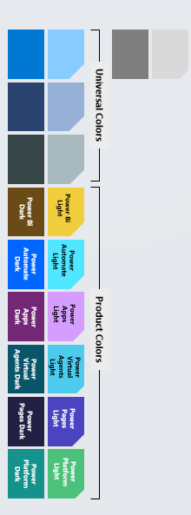

Copilots and Conversational AI
Microsoft 365
Conversational Experiences for M365
Biz Apps & Power Copilots
Conversational Experiences for D365 and Power products
Other Microsoft Copilots
Custom Copilots
Custom copilots and bots for enterprises and third parties
Copilot for Microsoft 365
Custom Enterprise Copilots
Service Copilot
Sales Copilot
Windows Copilot
Microsoft Security Copilot
Copilot for Power Platform
GitHub Copilot
…
Microsoft Copilot Studio Extend and customize 1st party copilots | Build custom Copilots
Bot Framework / SDK
Bot Service Channels
Azure AI Studio
Azure Cognitive Services
Power Platform Connectors
AI Builder

Slide 40























Copilot Studio Architecture
Microsoft Entra ID
Azure Bot Service
Azure OpenAI Azure AI Search
Dynamics 365 & other contact centers
Data Loss Prevention Policies
Bot Framework Skill
Bot Framework Skill
Environment
Channels
Azure Conversational Language Understanding (CLU) (optional)
Generative Answers, Actions, and Builder
SaaS
Entity
Custom
Escalate
Entity
Custom
Cloud Flow
Question
answering
Custom Topic
Entity
Entity
Cloud Flow
Custom Topic
Cloud Flow
Entity
Entity
Entity
Entity
Custom Topic
Connectors & HTTP Requests
AI Builder
Dynamic chaining: LLM-based multi-intents recognition (optional)
Plugin Action
System Topic
+ many more
Analytics
1000+ Prebuilt Data Connectors
Solution
Microsoft Dataverse
RBAC
ALM

Slide 41
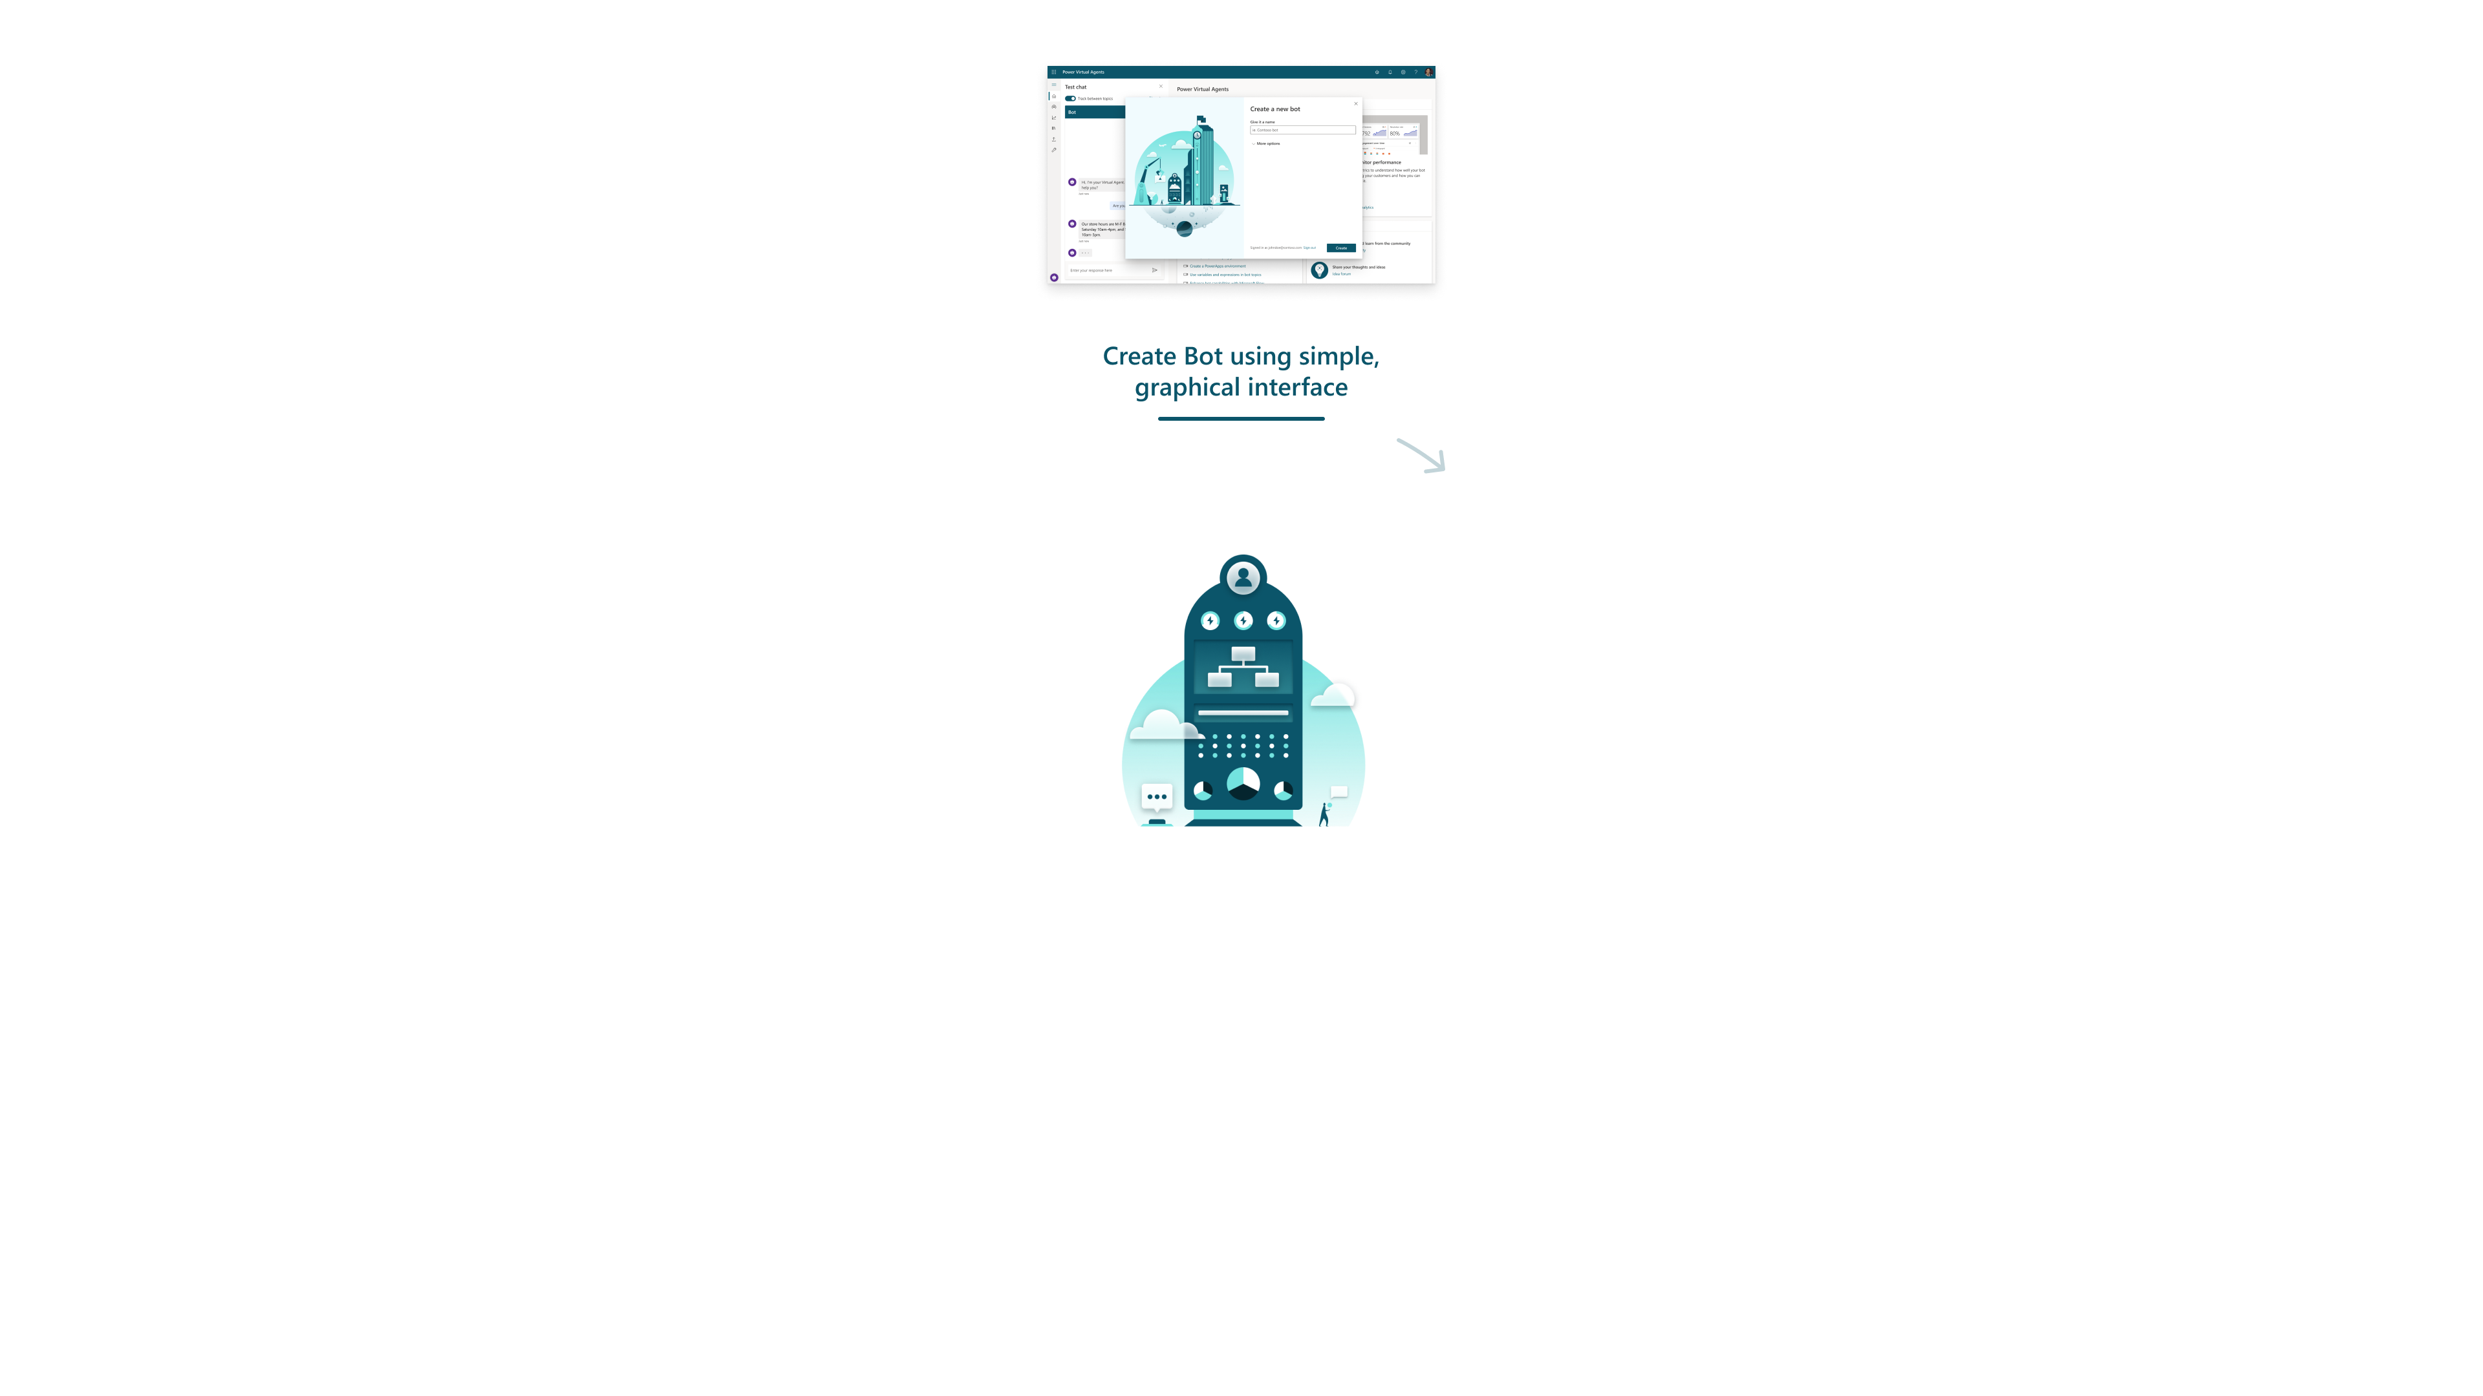
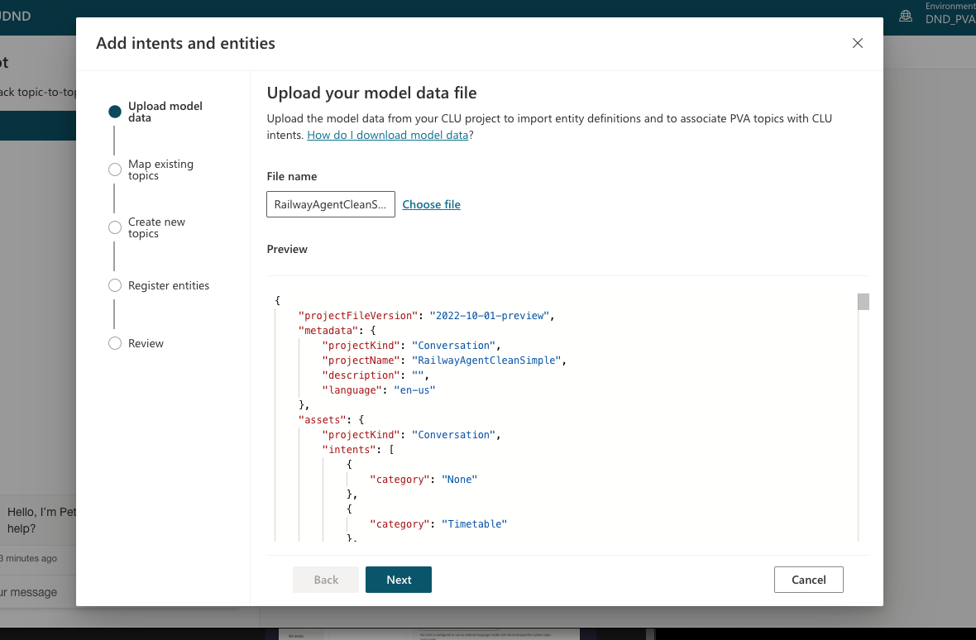




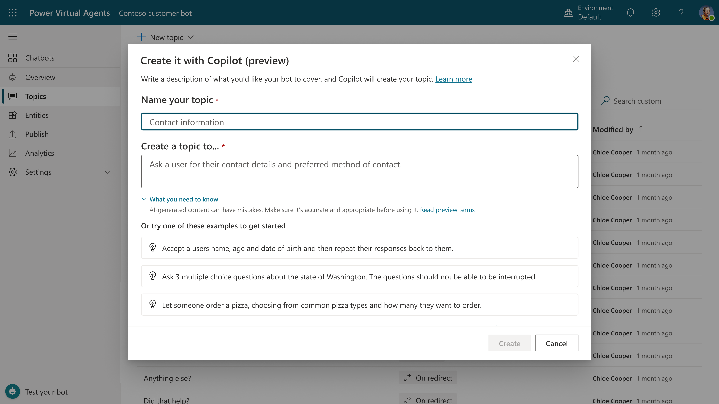
Create copilot with E2E SaaS and single pane of glass
Chat over knowledge with Generative AI Use generative answers and custom GPTs to provide enterprise specific answers over your files, websites, and internal shares
Conversational Services Integrate with Azure AI Studio, Azure Cognitive Services, Bot Framework and more
Monitor and Improve with Rich out-of-the-box telemetry and analytics
Create specific topics Supplement generative answers with specific, curated topics. Build them easily with the powerful graphical studio
Copilot Studio Build your own copilots
Publish the copilot to multiple channels, live instantly on the SaaS service
Actions & Plugins Create actions , plugins, or use pre-built Power Platform and OpenAI connectors to call your backends and APIs

Slide 42
Copilots and Conversational AI
Microsoft 365
Conversational Experiences for M365
Biz Apps & Power Copilots
Conversational Experiences for D365 and Power products
Other Microsoft Copilots
Custom Copilots
Custom copilots and bots for enterprises and third parties
Copilot for Microsoft 365
Custom Enterprise Copilots
Service Copilot
Sales Copilot
Windows Copilot
Microsoft Security Copilot
Copilot for Power Platform
GitHub Copilot
…
Microsoft Copilot Studio Extend and customize 1st party copilots | Build custom Copilots
Bot Framework / SDK
Bot Service Channels
Azure AI Studio
Azure Cognitive Services
Power Platform Connectors
AI Builder

Slide 43
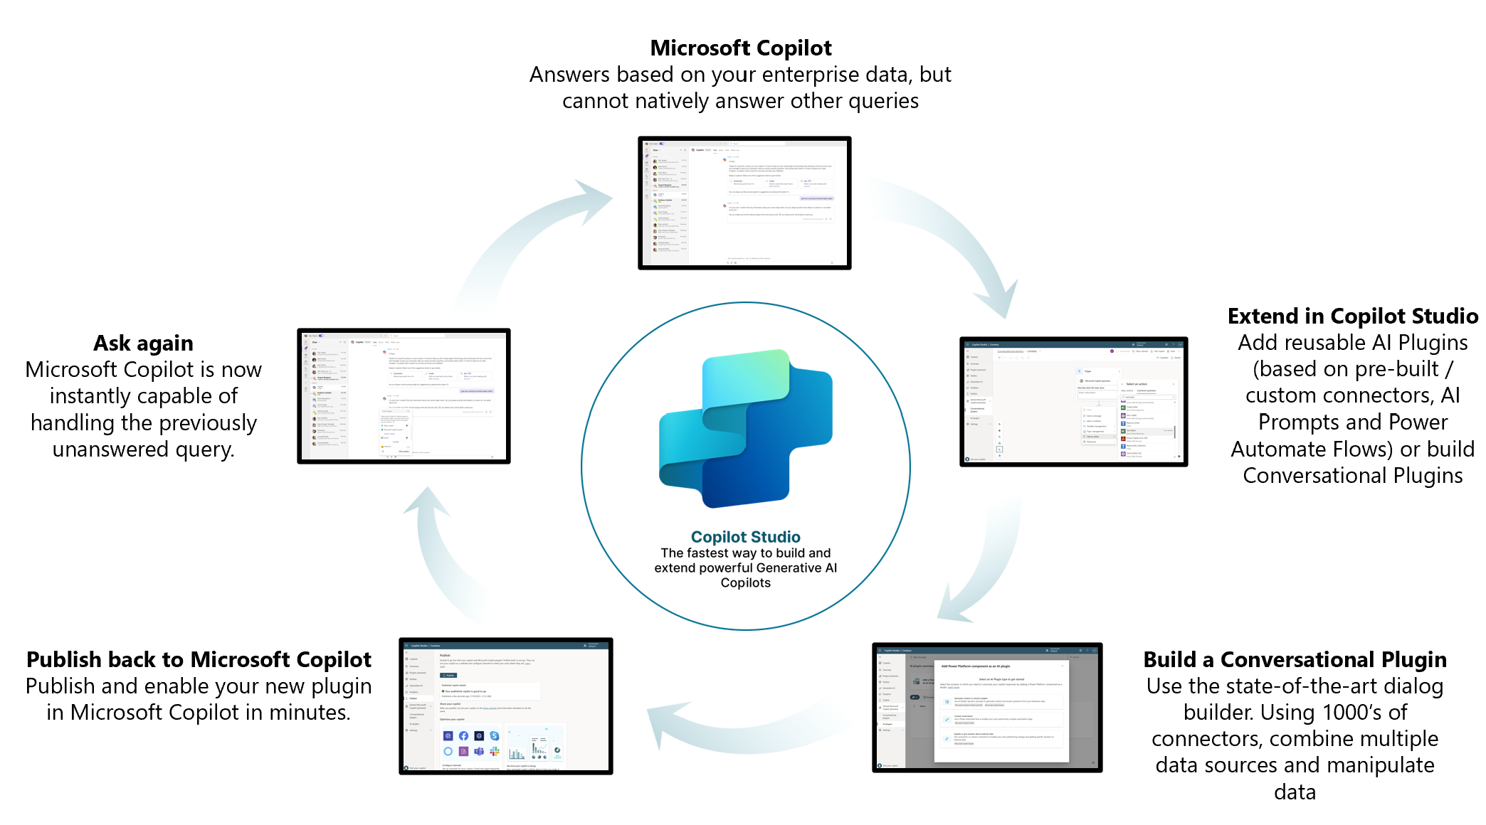
Customizing Copilot

Slide 44

Copilot Studio
Internal custom copilots
Customer facing copilots
Extend Copilot for Microsoft 365
World Class UX
Declarative
Rich Response
Intuitive
Ease of use
Natural language to build
Logic + Automation
Low code logic
Generative Answers + Actions
Power Automate
Custom Azure Skills
Next-Gen AI
Prebuilt LLM
Generative AI
Proactive suggestions
Bring your own Model (BYOM)*
Connected experience
Microsoft Copilot
Power Platform
1000+ Connectors
Azure AI Studio
Copilot Lifecycle
Test Pane
Collaboration
Solution Management
ALM Automation
Security + Governance
Trusted identity
Full visibility
Advanced RBAC
Granular DLP control
Microsoft’s end-to-end copilot building platform

Slide 45

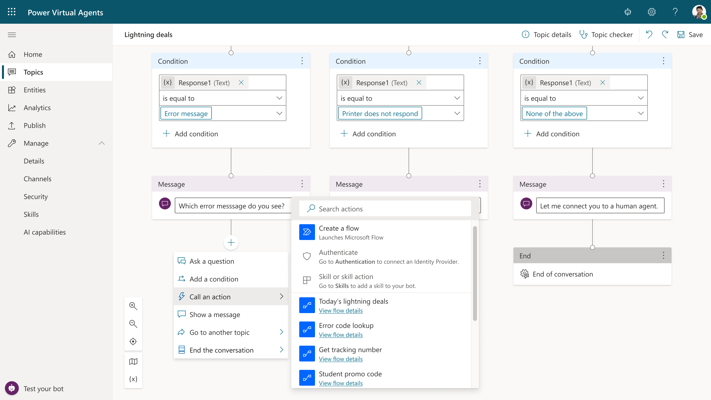









Automation studio
1
2
Discover
Automate
Use process mining to identify bottlenecks and opportunities for automation
With the Copilot Studio Process Advisor template, get a deeper insight into copilot conversation flows.
Create solutions by automating business processes with advanced AI, Digital Process Automation, and Robotic Process Automation.
Embed your automation flows directly into the conversation to drive action.
Power Automate’s digital process automation is included in Power Copilot Studio with 1000+ prebuilt data connectors and automation templates.
3rd party connectors, including custom and on-prem
Connectivity

Slide 46

1000+ connected experiences
Connect to more than 1000+ 1st and 3rd party services with built-in connectors for everything from Adobe to Zendesk to on-premises solutions.
List of supported connectors | Microsoft Power Automate
Notes:
Microsoft Power Automate offers connectors to 1000+ of the most widely used 1st and 3rd party applications, providing seamless connectivity and integration with the services which enhance your organization’s productivity. With the growing pace of business, Power Automate serves as the fabric which helps ensure your business stays ahead of the competitive landscape.
Power Automate is also designed for a hybrid ecosystem enabling connections to on-prem systems via the Data Gateway which we’ll learn more about later today. Also, Power Automate supports Custom Connectors to integrate with existing LOB systems. We’ll discuss this in greater detail later today.
Let’s now show you some of the powerful integration Power Automate offers to help make your organization more productive.
.

Slide 47


Robust, secure and compliant hosting platform
Data
Encryption
Data
Privacy
MONITOR
MANAGE
Compliance
Data
Loss Prevention
Security
Government
Hosting
Governance
Power Platform
Azure
Identity
Management
Compliance
Standards
Compliance leadership with standards and commitments including ISO 27001, FedRamp and EU model clauses
No standing access to data transparent operational model and 99.9% financial-backed uptime guarantee
Unified
Administration
System
Health
API Automation
& DevOps
CoE &
Best Practices
Usage
analytics
Activity
Logging

Slide 48

Microsoft’s Responsible AI principles
Privacy & Security
Building blocks to enact principles
Reliability & Safety
Inclusiveness
Tools and processes
Microsoft’s Responsible AI Principles
Training and practices
Fairness
Accountability
Rules
Governance
Transparency

Slide 49
Customer Copyright Commitment
Use Copilot services with confidence
We stand behind our Copilot customers
We are sensitive to the concerns of authors
Copyright guardrails are built into the product

Slide 50
Q&A

Slide 51
Let’s move on to the Labs!

Slide 52
Getting started with Copilot Studio
Labs 00 - 04:

Slide 53
Copilot Studio Information Architecture
Microsoft Dataverse Environment
Copilot (0, 1 or more copilots in an environment)
User Topics (1 or more in a copilot)
System Topics (8 pre-defined in a copilot)
Conversation Tree (1 per topic)
Trigger Phrases
Conversation tree
Trigger Phrases
Prebuilt Entities
Custom Entities
Prebuilt Entities
Custom Entities
Power Automate Flows
Bot Framework Skills
Power Automate Flows
Bot Framework Skills
Notes:
You can have one or more copilots in your Microsoft Dataverse Environment.
It’s common to have 25+ user topics within a copilot. Within each topic you construct a conversation tree.
A conversation tree consists of trigger phrases, multiple nodes, conditions, the ability to use entities and call actions (flows or skills). Note that to use Power Automate flows in Copilot Studio they must be in a solution, within the same Dataverse environment as the copilot
You can redirect/call another user topic or system topic from within a conversation tree.
Copilot Studio comes with:
4 pre-defined user topics that you can use or delete. These are useful for learning or getting started
8 pre-defined system topics. Think of these as building blocks for your conversation. They include: Greeting, Goodbye, End of conversation survey etc. Recommend minimal editing only for these topics e.g., greeting message only.

Slide 54
Copilot Creation Process overview
Test your copilot
Test your copilot
Publish your copilot
Create new conversation
Publish your copilot
Revise conversation
Measure your copilot performance
Measure your copilot performance
Create new topics
Revise topics
Create new copilot
Revise copilot
Notes:
Creating a copilot is an easy step by step process.
First you sign up for Copilot Studio and create a new copilot
Then create new topics with trigger phrases and build a conversational tree
Immediately you are able to test this using a test copilot and a demo website that can be shared with other users
Once you are happy with what you’ve built, you can publish this copilot to different channels that are made readily available by Copilot Studio
Each copilot also has performance analytics to enable a feedback loop so you can continuously and easily enhance your copilot to optimize the customer experience.
Revising your copilot follows the same process.

Slide 55
Introduction to Natural Language Understanding
Natural Language Understanding (NLU) is a subfield in Natural Language Processing (NLP).
It focuses on organizing the user’s unstructured inputs (utterences) so that the copilot can understand and analyze it.
Notes:
A fundamental component of Conversational AI is Natural Language Understanding (NLU). As human beings, when we talk to another person, we ask questions in our own language using words we know and can use at the time. A key component of a copilot experience for a user is to be able to ask the copilot questions, naturally and using the types of words they understand, not some special language or syntax that has to be specifically learned and is difficult to remember.

Slide 56
Example in action: topic triggering and slot filling
Utterance
“What’s the weather in Orlando?”
Topic: Check Weather
Entity: Location = Orlando
Notes:
When a question is asked by a person, the person who is asked the question understands the intent from the question and acts accordingly. This discovered or assumed intent may be following up with a sentence, comment or even another question. What can make these interactions complex is matching the intent to the correct intention of the original user asking the question. This is understood using NLU technology – Natural Language Understanding – so a Conversational AI application can understand the natural language human beings use, recognize intents from questions, and then acts accordingly.
In traditional Conversational AI Development, developers have had to create, train, test and deploy a separate NLU layer with their logic and UI layers together as well as additional layers and integration around specific follow up behavior. In Copilot Studio, our aim is to democratize Conversational AI and make it easier for organizations to get started, manage, deploy and iterate on their copilot by providing both low and pro code authoring experiences and capabilities. Copilot Studio comes straight out of the box with its own pre-trained Natural Language Understanding (NLU) capabilities, meaning a user does not need to use or provision their own NLU service, and can get started and train their copilot simply by entering Trigger Phrases within a topic. Additionally, standard, and custom entities can be detected on intent recognition or within an ongoing conversation by extracting the subject of user’s sentence and being stored and used as a variable.

Slide 57
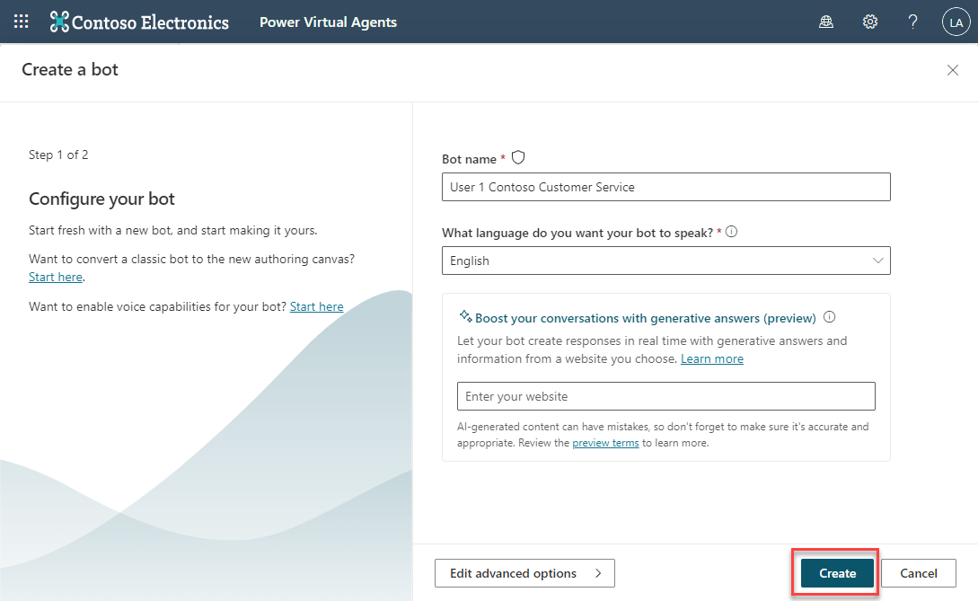
Create a new preview copilot
Open the Copilot Studio designer
Copilot Studio
Select ‘create copilot’
Notes:
Copilot Studio makes creating a copilot very easy to do.
Open the Copilot Studio designer and click on the ‘copilot’ icon and then select ‘new copilot’.
Choose a name for your new copilot.
Select your language
Select your Environment.

Slide 58
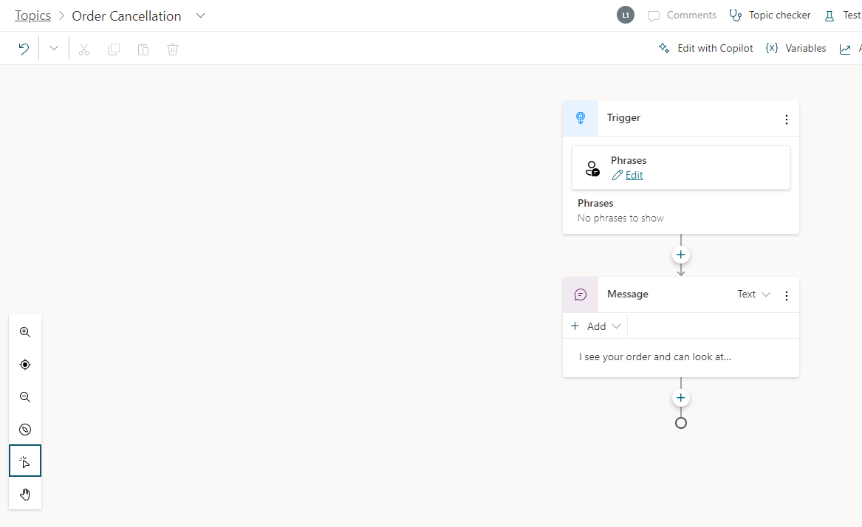
Supported Languages
Copilot Studio supports copilots in many different languages
Copilot Studio Unified Authoring Preview is currently available only in English when creating your Copilot
There will be more supported languages throughout Preview
Notes:
You can create copilots in Copilot Studio in a number of languages.
Each copilot speaks one language, it’s not a multilingual single copilot
You specify the target language when you first create a copilot
For a full list of languages supported, see: https://docs.microsoft.com/en-us/power-virtual-agents/authoring-language-support

Slide 59
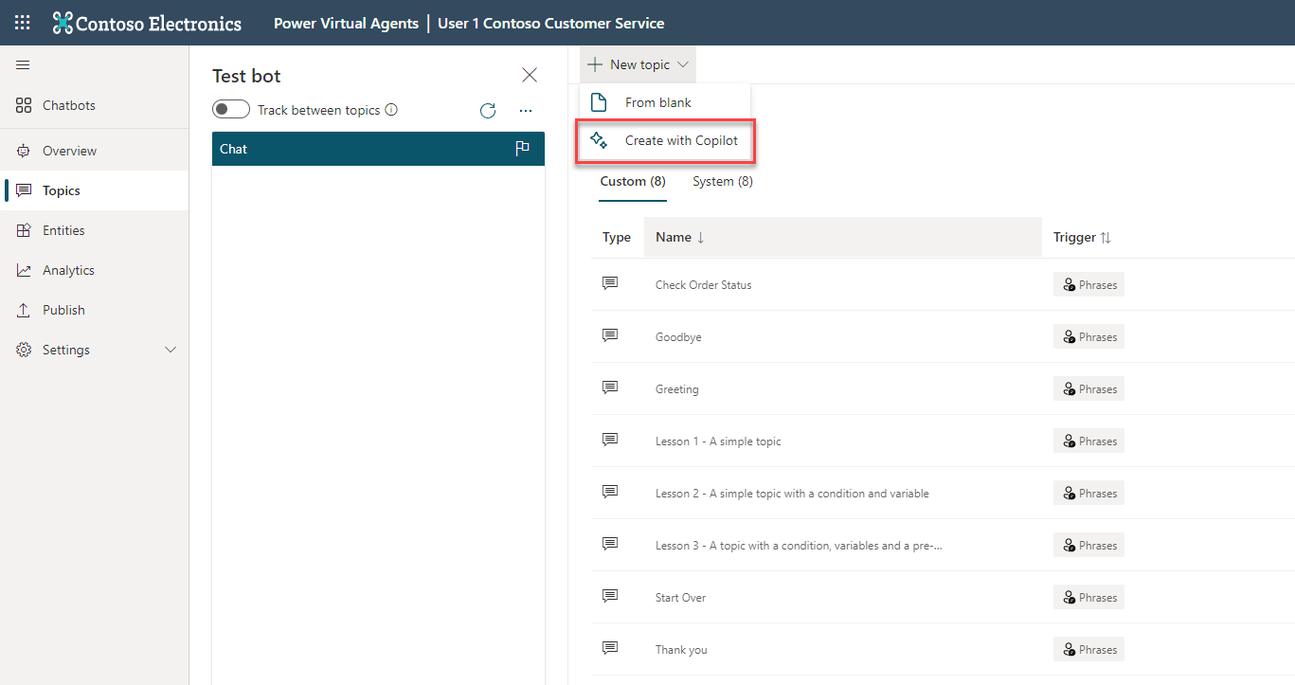
View topics
A copilot comes with 4-7 User topics & 8 system topics
Using one of the 4 topics to get familiar with the structure
Notes:
When you create your copilot, you need to decide what business scenarios you want your copilot to address. You’ll create a topic for each scenario/question you want the copilot to address.
4-7 depending if you choose to use the Lesson Topics

Slide 60
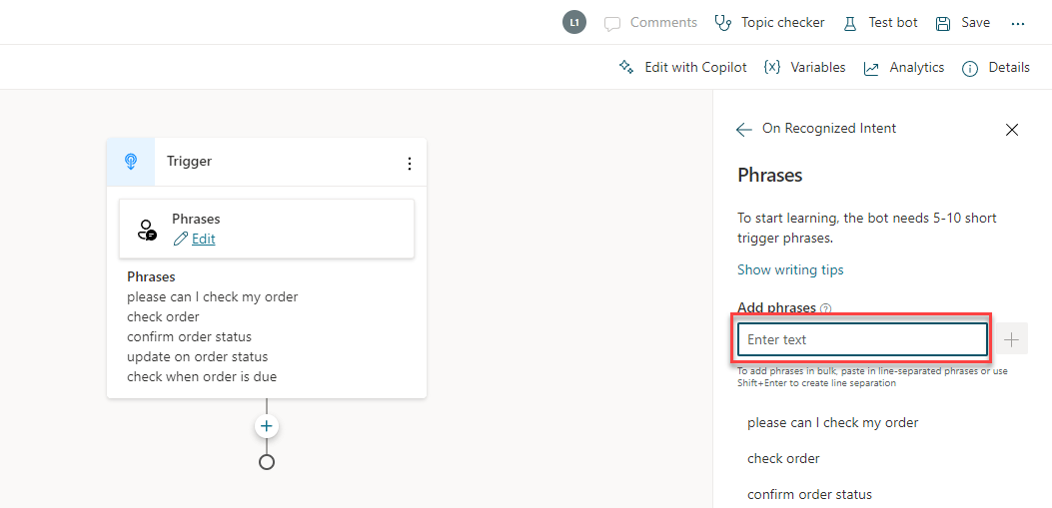
Add conversational trigger phrases
For a topic you’ll define a few trigger phrases
A trigger phrase is a way to describe an intent, it captures the way a customer might ask about a problem/issue. E.g., “problem with weeds in lawn”
You only need to provide at least 5 phrases – the AI will parse whatever the user says and trigger the topic closest in meaning to the user utterance
Notes:
Your copilot must have the appropriate trigger phrases relevant to your topic.
A topic has trigger phrases—these are phrases, keywords, or questions that a user is likely to type that is related to a specific.
The AI uses natural language understanding to parse what a customer actually types and find the most appropriate trigger phrase or node.
You should start with 5-10 trigger phrases for each topic. Your phrases should be semantically different. They don’t need to be full sentences.

Slide 61
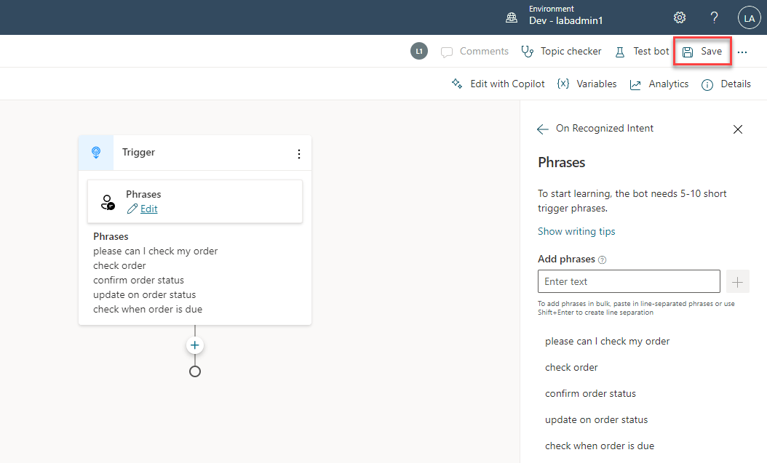
Open the authoring canvas and begin editing a topic
Open authoring canvas to view the conversation tree
You’ll see the trigger phrases at the top. You can edit the conversation tree, adding questions the copilot should ask, things the copilot should say etc.
Notes:
Open the authoring canvas and begin creating your copilot. The easy to use and understand dialog tree enables any user to start creating a powerful copilot experience.

Slide 62
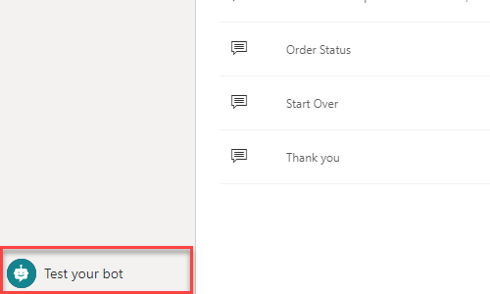
Test your topic as you construct it
To test what you’ve created click on test copilot (bottom left) to expand test window
Turn on “Track between topics”. This lets you trace your way through both this topic and any others you call

Slide 63
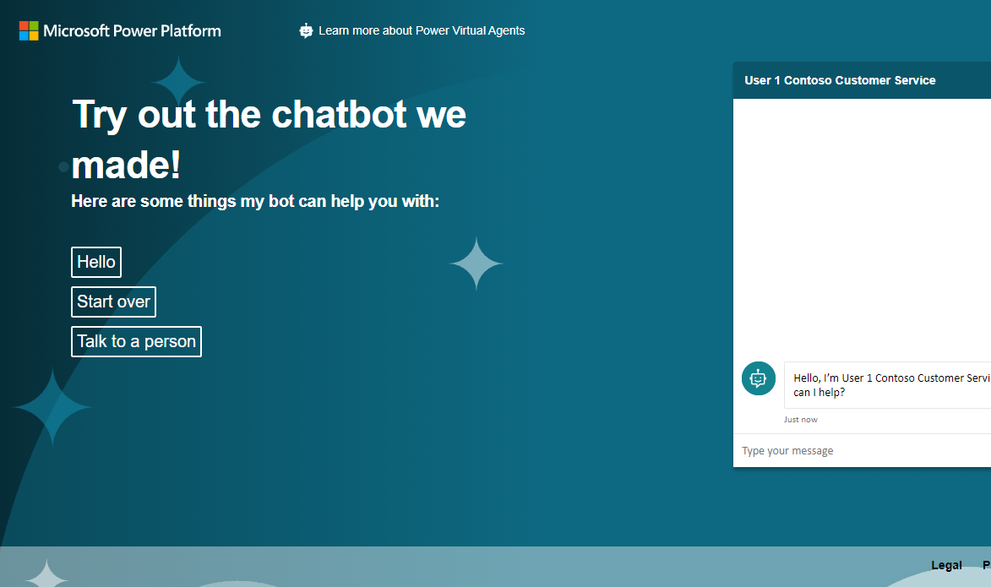
Publish to demo website
Publish to demo website and share the URL with colleagues so they can try the copilot
Add screen shot with that publish to demo site show and demo page

Slide 64
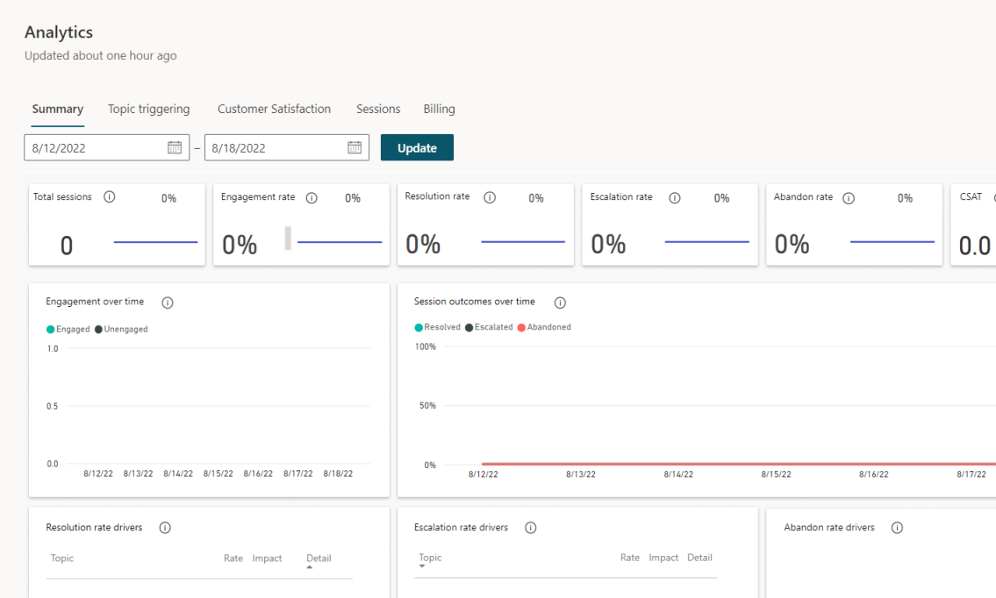
Enhance your copilot from Analytics
GAIN VISIBILITY OF MANY PARAMETERS
Summary charts
Engagement over time chart
Session outcomes over time chart
Resolution rate drivers chart
Escalation rate drivers chart
Abandon rate drivers chart
Notes:
Easily see what’s working and what to improve
Analyze copilot/customer conversations to better understand how specific topics are performing, what’s impacting your CSAT, and identify where there is room for improvement
Quickly figure out what to build next
Easily see which conversations are going to human agents and determine which topics to teach your copilot next

Slide 65
SECTION SUMMARY
Copilot Studio enables users to create a copilot in just minutes
Offers an easy to use designer to help create unique customer copilot experiences
Part of the Microsoft Power Platform
Built on Microsoft Dataverse

Slide 66
Lab 00:
Getting Setup and Access

Slide 67

Setup your Copilot Studio Environment & Log In Lab 00
You should be able to login to your environment using the instructor provided logins
You will have a Copilot Studio trial license assigned to you
To test you have access to the latest Copilot Studio Preview functionality, navigate to web.powerva.microsoft.com and you should see the following features when you first log in (next slide)

Slide 68
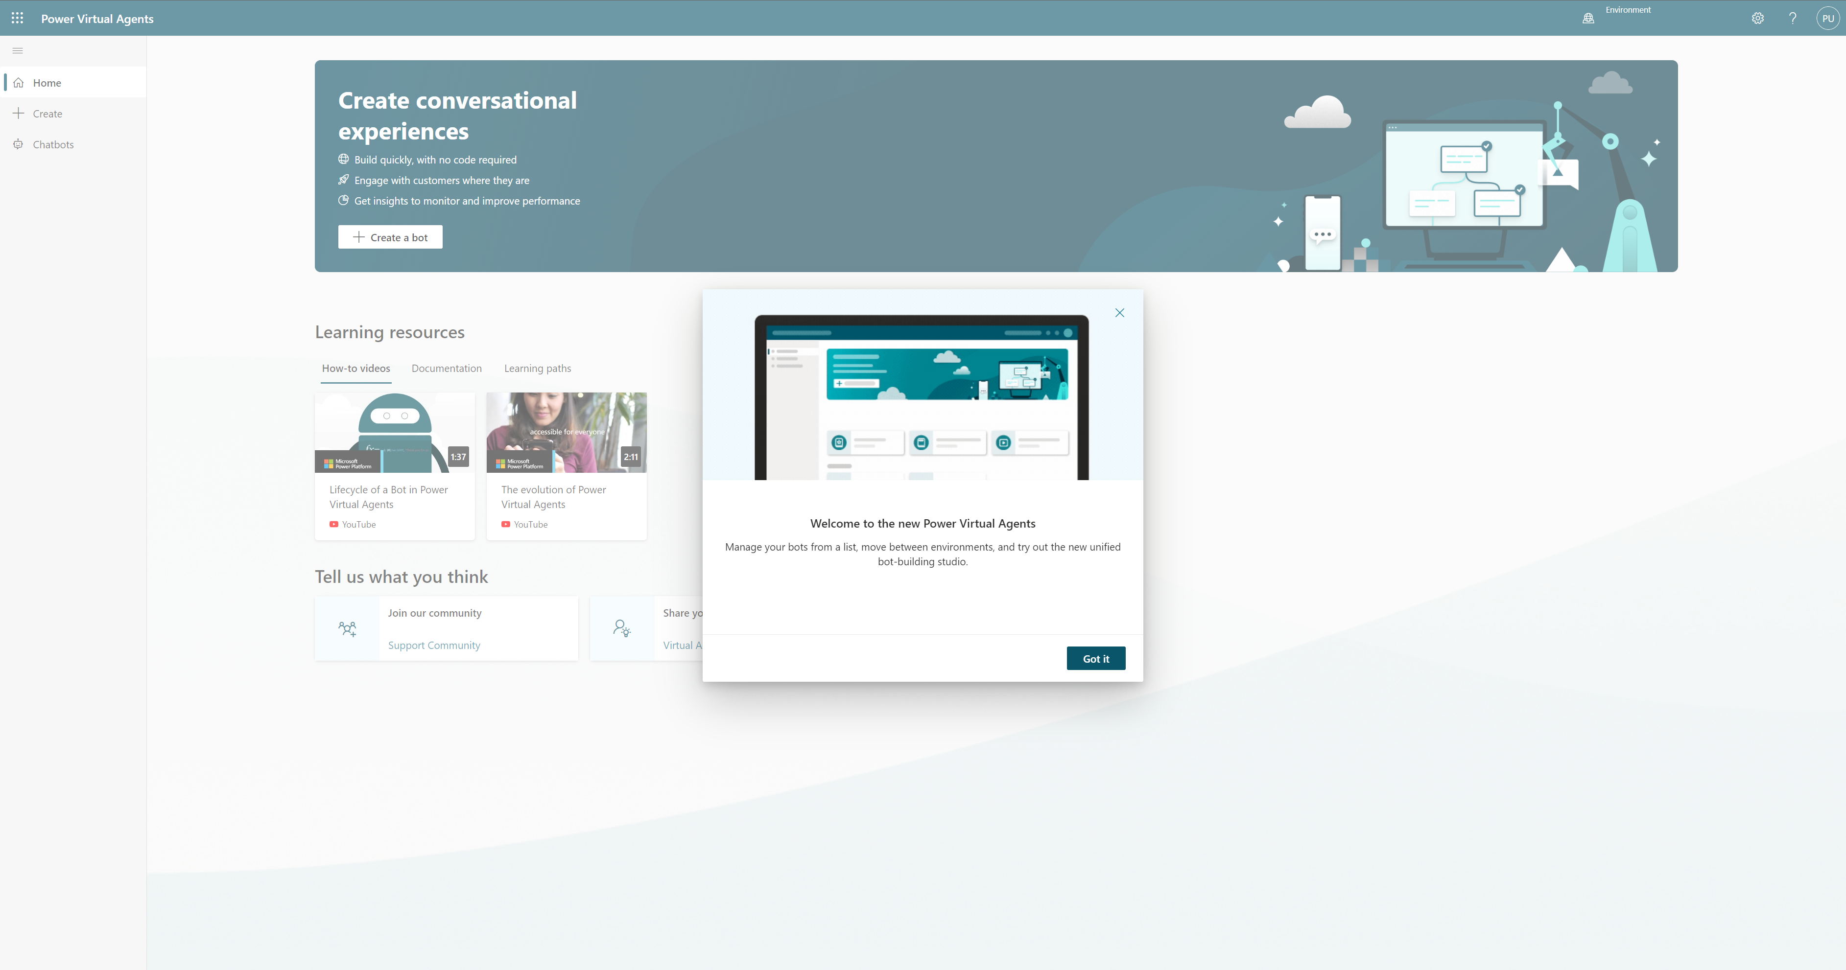
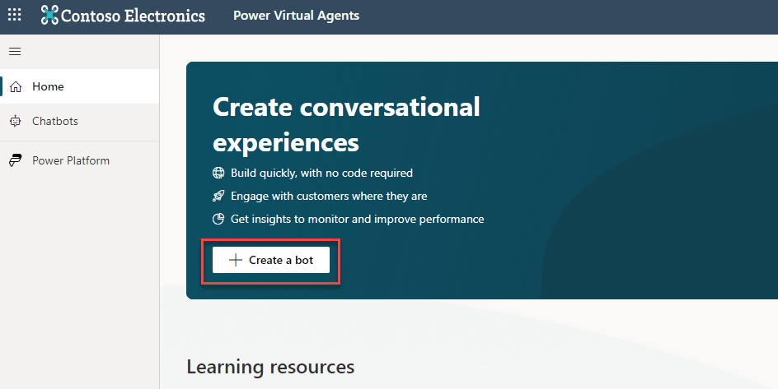
A welcome dialog highlighting the latest version of Copilot Studio
Click ‘Create a copilot’ and you should be able to start the copilot creation wizard

Slide 69
Lab 00:
Checking Access

Slide 70
Lab 01:
Planning your first Copilot & Conversational Design

Slide 71
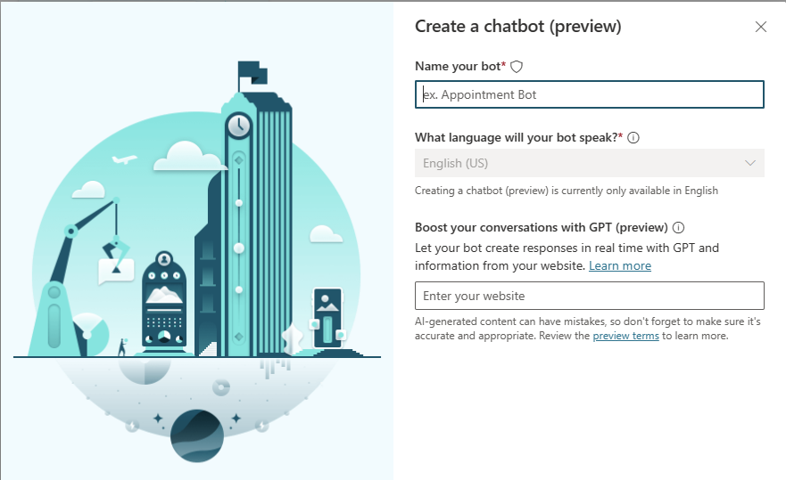
Generative Answers
Public Preview
Make copilots immediately useful by creating responses in real time with GPT without needing to create Topics
Search web address using Bing and summarize relevant results using GPT
Dramatically increases the questions that your copilot can answer in seconds without the complexity of creating FAQ or Topics
Reuse of existing content from your organizations data
Multiple Sources (Limited Preview)
Internal Documentation support allowing internal knowledge sources such as SharePoint (Limited Preview)

Slide 72
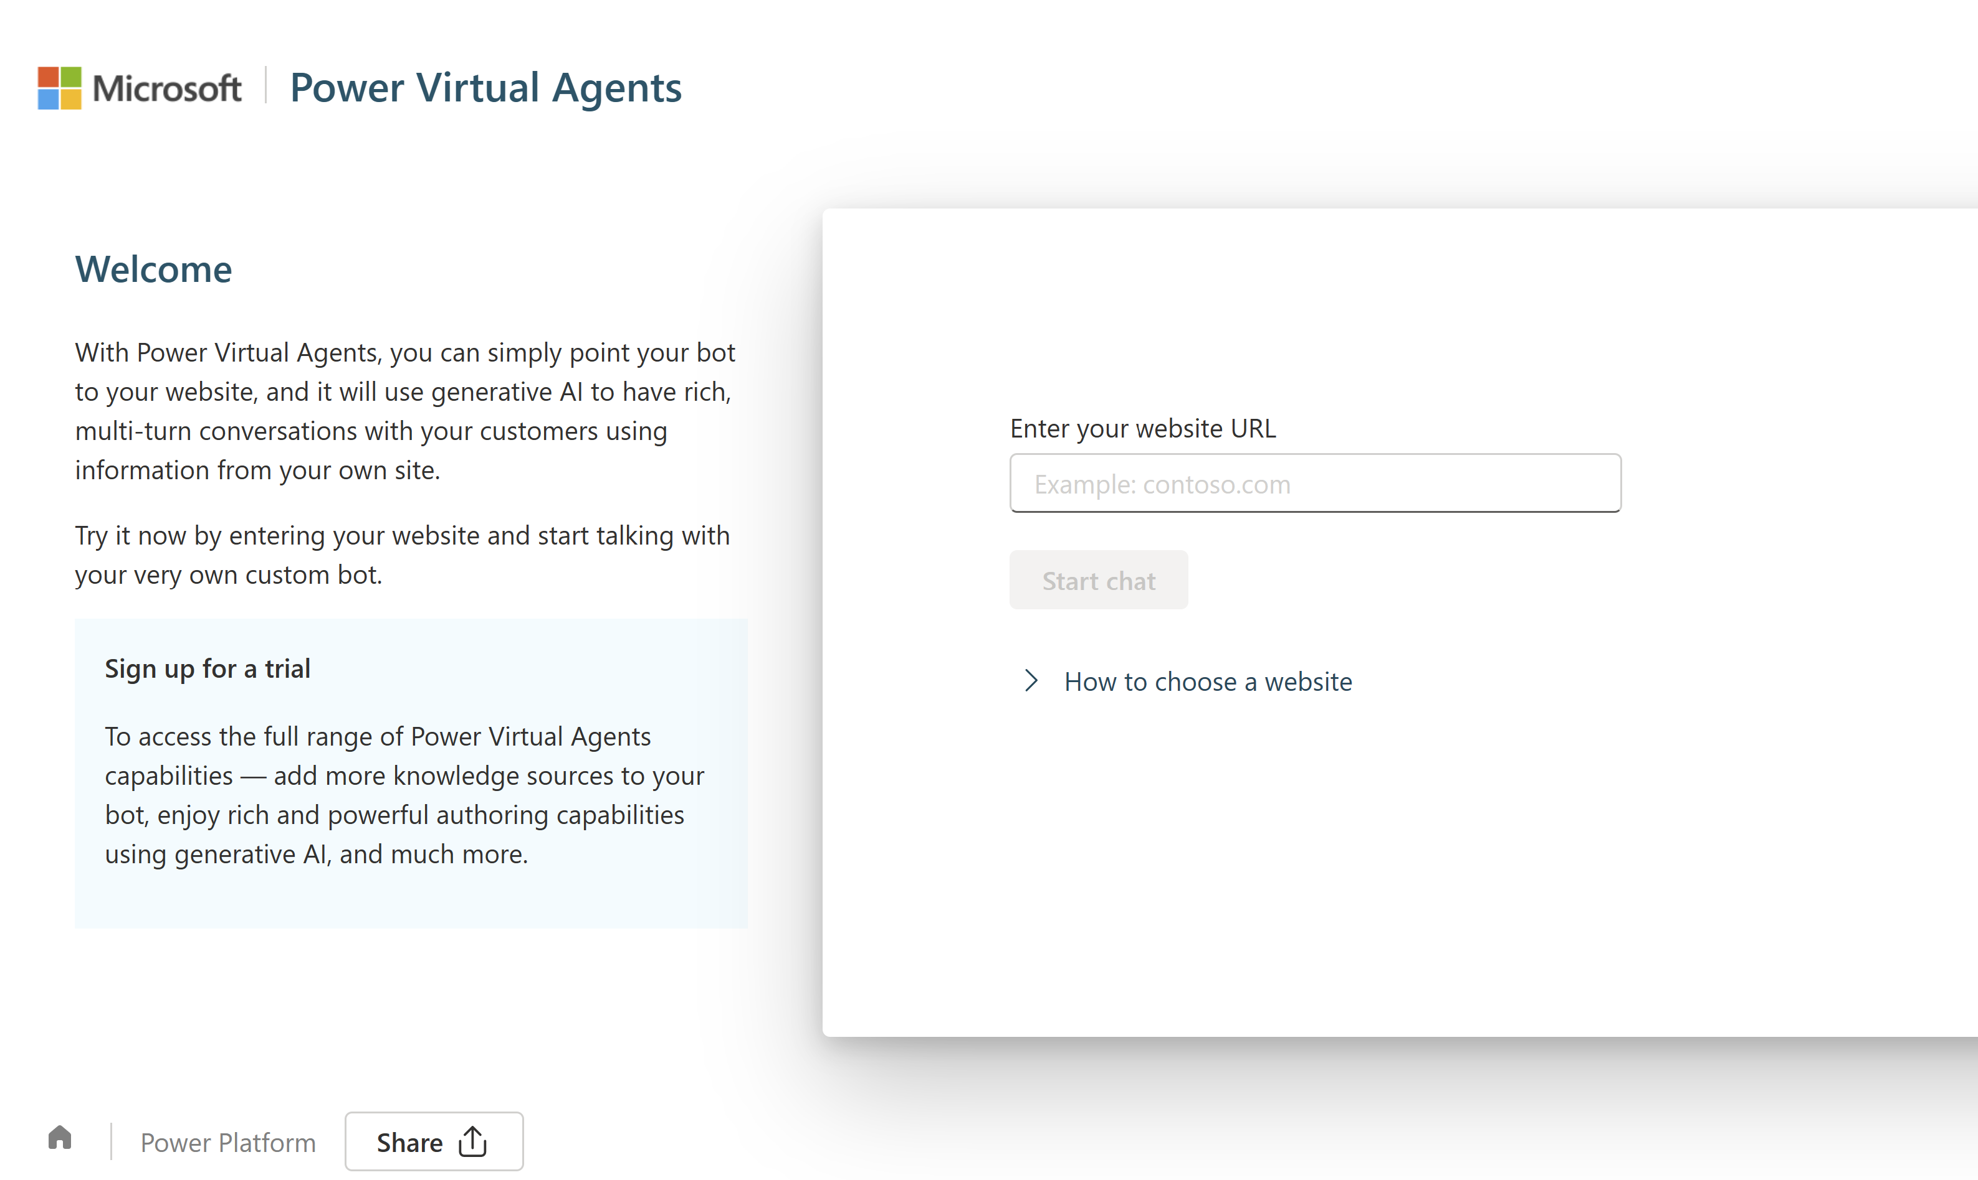
Try Generative Answers in Copilot Studio
Try one of the latest features in Public Preview – Generative Answers
Open a new tab in your browser and to to the Try It experience as shown on the screen
Add a public facing website and start asking questions!
Notes:
So, let’s try out one of our latest features in Copilot Studio, in public preview, Generative Answers. The great news is you don’t even need to log in to your copilot to complete this lab, and you can open a new tab in your browser instead go to the Try It experience here - Power Virtual Agents (microsoft.com) to open the web page as you can see below:

Slide 73
Planning your first copilot - Ideation
Planning your copilot is essential for the success of your project
Setting goals when implementing any business system should be driven from business value
Take your time planning and do not rush

Slide 74
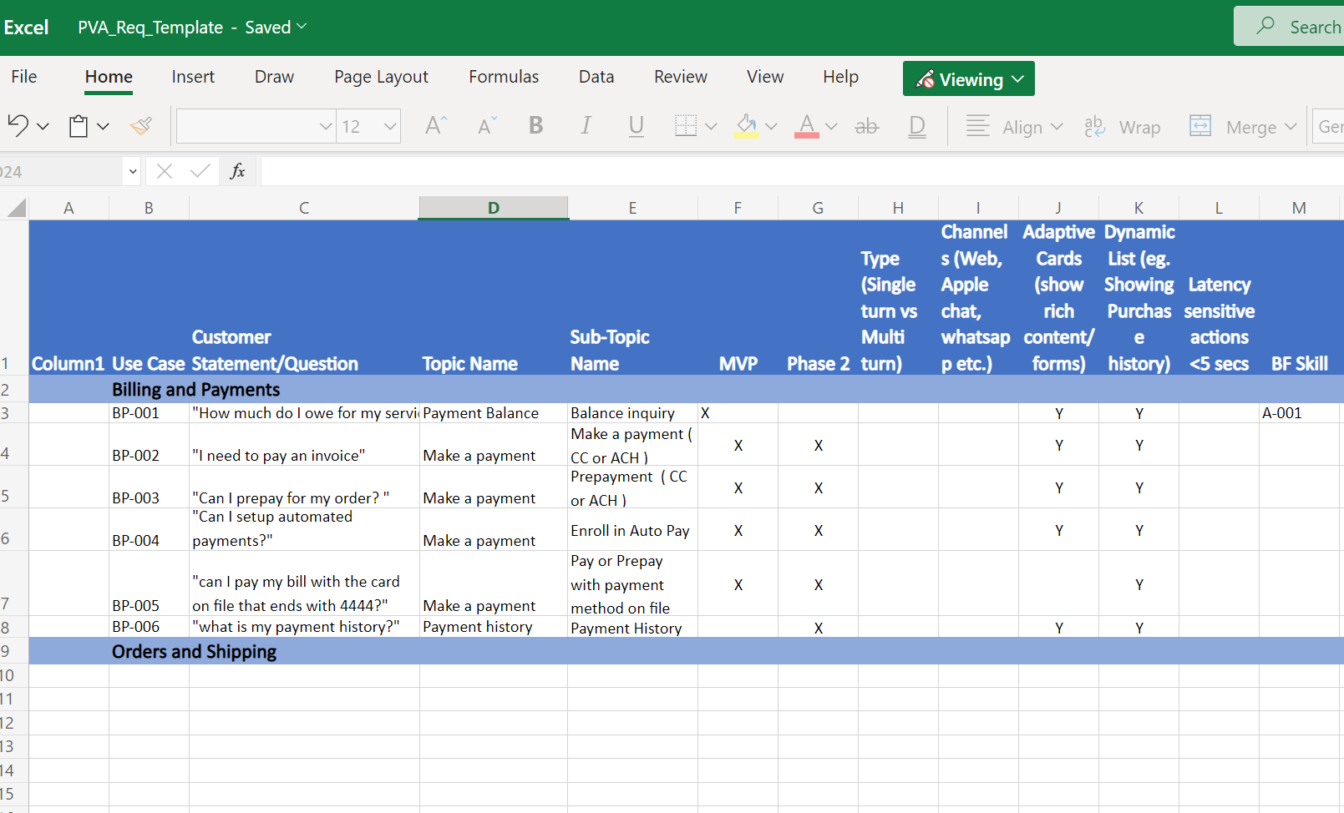
Planning your first copilot – Requirements Gathering
Topic Planning is essential to be able to map the range of topics you want to enable for your users
Use the template provided in the Bot Building Handbook to log key information about the topics
Additional information can be added and developed as you go

Slide 75

What makes a copilot successful?
Knowing your customer
Having accurate, latest and effective content
Knowing when to hand off to a human
Understanding the customer’s request and connecting it to the right topic
Providing personalized, context-aware help, and taking actions for the customer

Slide 76
Types of conversation topics
People use your copilot with a specific issue (“topic”) to address or resolve. You can loosely categorize topics into 3 types:
Informational
What is…? When will…? Why…?
Task completion
I want to… How do I…?
Troubleshooting
Something isn’t working right. I got an error message
Notes:
Informational, Task Completion, and Troubleshooting are different types of topics that the https://wave.video/live/5lfwS9zySIkhljHl can support. You may also need some topics that are just there to take ambiguous user questions (“I need help” or “shopping”) and ask for clarification so you can then route the user to the correct topic.
When you are considering which business processes to automate, look for the ones with the highest traffic and those where the task can be completed in the copilot without the need for human involvement. Don’t just replicate what your website can already do – most customers are familiar with websites and will accomplish these tasks themselves without needing to interact with a copilot. Look to create topics for things which generate a high volume of calls. Build automations for those to start with, and then work on the longer tail of other topics over a period of time.

Slide 77


Designing a topic
Identify the topic
List all scenarios
Design a high-level conversation tree
Design solutions
Validate and iterate on the design
Choose a topic your copilot audience will ask about
Focus on high-impact topics first
Put your customer empathy hat on … topic design requires understanding both sides of the conversation
List all possible scenarios
Think about informational needs, task completion, and troubleshooting
Use your favorite tool to draw the conversation tree
What is the fewest number of questions you can ask to understand the situation enough to provide the right solution?
Integrate with Power Automate to personalize and speed issue identification
Make answers clear and concise so users can scan information quickly
Integrate with Power Automate to take action on the user’s behalf
Read the dialog out loud before publishing
Get analytics and read session transcripts for further optimization

Slide 78
Copilot conversation styles

Slide 79

Qualities of a good conversation
Cooperative
Goal-oriented
Fast
Turn-based
Truthful
Polite
Source: Erika Hall, Conversational Design
Notes:
Good quality conversation styles you need to adopt:
Cooperative: without cooperation between the copilot and the customer there is no conversation. Conversation flow should be built in a manner that the customer does not need to put in any effort or have any special knowledge or understanding of your design
Goal-oriented: basic principle of conversation design. Every step or turn needs to have a goal in mind. Why is it being asked or shown to the user?
Fast: successful conversations move at a fast past.
Turn-based: It is also critical to provide the right information at the right time and verify that it’s correct before moving forward. Poor interaction requires the participant to backtrack and make corrections, which slows everything down and adds effort to the process
Truthful: Humans have strategies to prevent and resolve misunderstanding quickly in context. Similarly, copilots should validate information before using it to take action.
Polite: there is nothing as polite as respecting the time of someone who has given you their attention. Politeness can also be achieved by making customers investment of time more productive than expected, for example, by anticipating additional needs before they’ve thought to ask by offering additional choices or fewer choices in a polite manner, depending on the context.

Slide 80
Style: How to sound conversational 1/9
Customer conversations should emulate the best elements of any conversation — personal and polite, friendly and supportive
A few stylistic changes in writing can impart warmth and familiarity to your brand voice
Don’t overuse exclamation points to convey energy. It’s easy to rely on them for this purpose, but too many, in the wrong places, could be interpreted as insincere and robotic
Hey Bryan! Would you like the usual — a large cheese pizza?
So you know, there is a buy-a-large-get-a-small-free deal going on through Saturday. Do you want to try this deal?
Yeah!!
Great! Let me get your order started for you.

Slide 81
Style: How to sound conversational 2/9
Use short sentences
Be positive
Use active voice
Sounds great! Let me get that started for you.
Let’s get started. I have a couple questions. Should only take a minute.
No problem. I can resolve this for you.

Slide 82
Style: How to sound conversational 3/9
I’m going to ask you a couple questions. It should only take a minute.
Good choice. I have a couple suggestions based on what you’ve selected.
Great.
Use contractions: “I’m” instead of “I am.”
Select a pronoun to represent your brand agent in chat and be consistent: “I” or “we.”

Slide 83
Style: How to sound conversational 4/9
Be consistent with tone and style so the conversation sounds like it’s with the same agent and brand
Do
Don’t
Hi there. Welcome to the Store Assistant. I can help you make a return or exchange.
Hi there. Welcome to the Store Assistant. I can help you make a return or exchange.
Let me know at any time if you’d like to chat with a live customer service agent.
If you wish to be in contact with a live customer service agent in regards to your problem, please click the button below.
I want to return an item
Tone shifts to formal
I want to return an item
OK. Could you provide your order number, please?
OK. Provide your order number.
Demanding tone

Slide 84
Style: How to sound conversational 5/9
If you’re using website documentation to answer a question, break sections down into short, scannable graphs
Do
Don’t
How to reset your password: 1. Go to https://account.live.com/password/reset. 2. Select the reason for resetting your password and the alternate contact info where you can receive a security code to verify your identity. Note: This alternate contact info is part of the security info you already added to your Microsoft account.
How to reset your Password If you cannot remember your password, go to https://acount.live.com/password/reset and select the reason for resetting your password. Then include the alternate contact info where you can receive a security code to verify your identity. Note: This alternate contact info is part of the security info you already added to your Microsoft account.

Slide 85
Style: How to sound conversational 6/9
Pace the conversation in short, scannable units
Break up messages into separate, readable blocks to make the pace of the conversation feel more natural
Make sure the copilot doesn’t respond so quickly that it rushes the customer. Add a minimum delay if necessary
Check in to make sure the user is following the conversation after explaining or answering a question, particularly a complex one
Before we begin, what type of account do you have?
Student
OK, what type of device are you using?
Tablet
Great! First, we need to reset your credentials. I’ll walk you through how to do this.
Open Spotlight by selecting the magnifying glass at the top right of your setting.
Then search for and open CountrySetting.

Slide 86
Style: How to sound conversational 7/9
Maintain a friendly tone when helping to complete the task
Tailor the tone of the copilot’s responses to the context. If it’s something serious—like billing or cybersecurity—be empathetic but brief and straightforward. If it’s a more mundane situation (like creating a new account), the tone can be more relaxed.
Exclamation points don’t express energy or excitement. Strong writing does, particularly strong verbs. In your desire to help, avoid sounding condescending or insincerely enthusiastic.
Don’t
Hi, I need help with my bill.
Oh! The first step is understanding how your service is billed.
Bills can be complex!
Do
I understand you need help with your bill. Can you tell me in a few words what the issue is?
Charges
Account Settings
Payment

Slide 87
Style: How to sound conversational 8/9
Invite the user into the conversation on a regular basis by asking questions or making suggestions.
Respond to the customer in a timely manner.
If the copilot may take a while to process the customer’s request, let the customer know what to expect.
Hey Bryan, just checking to see if you still need help with your bill?
Yes sorry
No problem. Do you have your account number, or do you need help finding it?
My account number is 1234567
Thanks! Please wait while I grab your billing info.

Slide 88
Style: How to sound conversational 9/9
Customers abandon a chat when the prompts are lengthy, so keep them brief. To keep your writing simple and straightforward, use the Flesch-Kincaid Grade Level feature in Microsoft Word or an app like Hemingwayapp.com to figure out the grade level for your scripts. In general, the lower the grade level, the better.
What will it be primarily used for?
School
OK. What type of activities will you be using it for?
Homework
Which of these features is most important to you?
Memory
Alright. Here are some options for you…

Slide 89
Planning your first copilot - Ideation
Planning your copilot is essential for the success of your project
Setting goals when implementing any business system should be driven from business value
Take your time planning and do not rush

Slide 90
Planning your first copilot – Requirements Gathering
Topic Planning is essential to be able to map the range of topics you want to enable for your users
Use the template provided in the Bot Building Handbook to log key information about the topics
Additional information can be added and developed as you go

Slide 91
Lab 01:
Planning your first copilot
(Lab Time)

Slide 92
Lab 02:
Creating your first copilot

Slide 93
Creating your first copilot
Take the time to familiarize yourself with the User Interface
Don’t try to do everything at once. Lab 01 keeps things simple with creating a topic, testing and publishing
Even if you finish the lab quickly, try repeating the same steps to become familiar with core actions

Slide 94
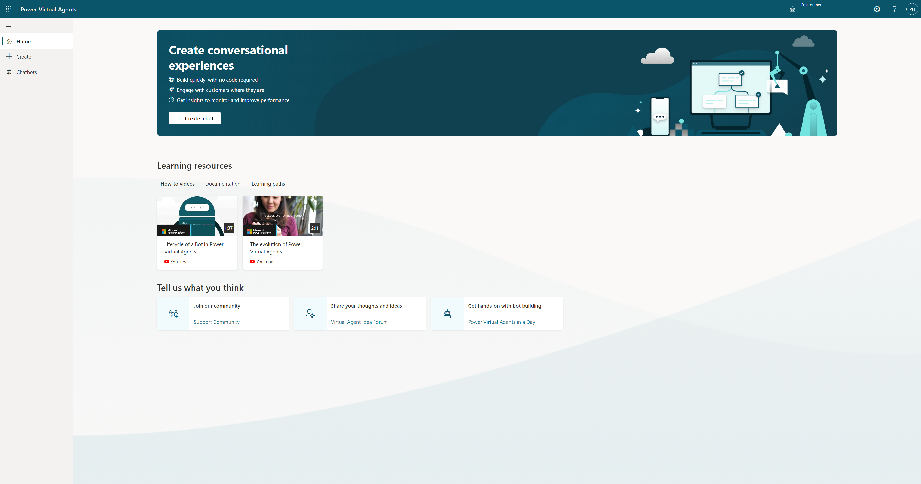
The ‘Home’ page

Slide 95
A welcome dialog highlighting the latest version of Copilot Studio
Click ‘Create a copilot’ and you should be able to start the copilot creation wizard

Slide 96
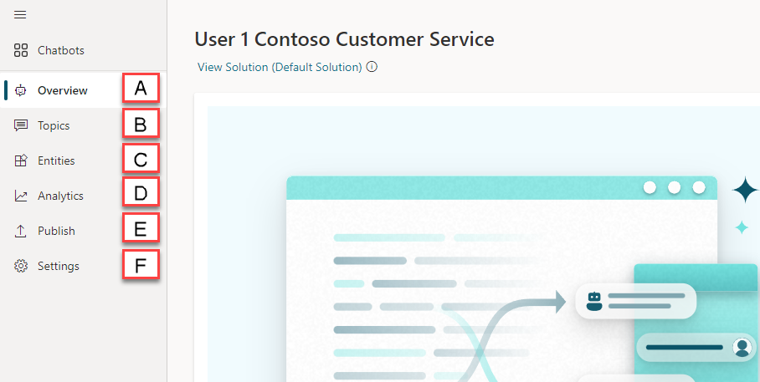
Notes:
Overview page, Displays your homepage including links to Test your copilot, publish copilot and links to documentation
Topics page, where you view, delete, create and edit conversation topics.
Entities page, where you view and create entities that Copilot Studio can recognize in customer conversations and load into variables.
Analytics page, where you view metrics to monitor how well your copilot is serving your customers and find ways improve it.
Publish page, where you can publish the copilot for team testing or to engage with your customers.
Settings page, where you can select General to change your copilots name, image and get data like environment ID, Tenant ID and Bot app ID. Channels (such as your website or Facebook) you want customers to interact with your copilot, Agent Transfer to configure connecting Copilot Studio to engagement hubs, configure Security to let your users sign into their account with you when using the copilot, and extend your copilot’s conversational capabilities AI Capabilities

Slide 97
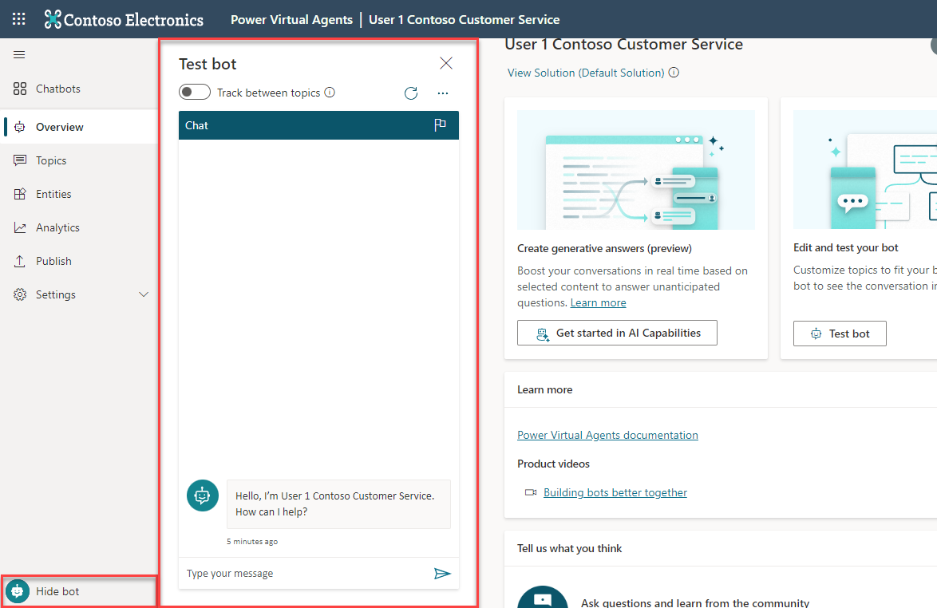

Slide 98
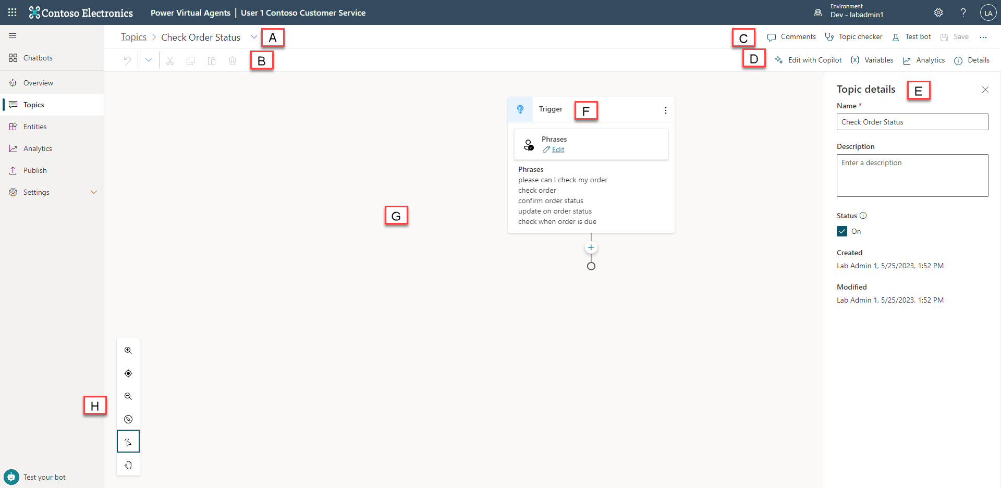
Notes:
Topic Title is the name of the topic you are currently authoring and is visible in the Topics page.
Productivity Bar is where you have access to productivity tools like copy and paste which is available in Preview
Topic Checker, Test and Save buttons include the Topic Checker which can be run anytime from the authoring canvas to check if there are any errors in your topic that the platform can detect , example include missing messages in message nodes. Test opens the copilot testing panel on the left side of the screen, and the save icon which is available when there are unsaved changes, saves the topic. There is an extended menu ‘…’ button available here as well, which opens the code editor in Copilot Studiopreview, allowing users to switch from the graphical view and the code view seamlessly
Variables, Analytics and Topic Details buttons provide three areas to access all the variables available in this topic and globally, analytics shows key metrics that are tracked within a time period including sessions and abandon rate, and the details menu allows you to change the name and description of the topic, and turn it on or off.
Properties are an extended menu item that allows for additional information or control depending on what is selected. Some items will not have any extended options and so this area can sometimes be empty, or for example selecting a question node’s properties, additional options become available in this section such as ‘Question Behaviour’
Nodes are what are referred to as the items within an authoring canvas in Copilot Studio and often have a type which drives what options are available and required. Examples include the message node, question node, or topic node.
The Authoring Canvas is where you would author your topic and is referred to a canvas due to the empty space that is gives you to build and connect nodes. It may look empty to begin with but as soon as you start adding nodes such as conditions, it will fill up fast!
Authoring Canvas Controls are what can be used to navigate the authoring canvas, which can become large for extensive topics. Controls included are zoom, grab and selection.

Slide 99
Best practices for writing topic trigger phrases

Slide 100

Trigger phrases – Definition
Trigger the copilot to begin a conversation about a specific topic

Slide 101
Guidelines for better trigger phrase design
Clearly understand the goal and scope of the topic
Make sure the trigger phrases are semantically different
Start with 5 to 10 trigger phrases
Use the words your customers use!
Shorter trigger phrases with fewer than 10 words are generally better
Avoid trigger phrases that are highly ambiguous among different topics
Notes:
Here are some guidelines on writing better trigger phrases to ensure the right topics are triggering.
Trigger phrases should align with the goals and scope of the topic
Writing good trigger phrases using similar words that your end customer will use is very important in building successful copilots
In order to have the right coverage, ensure you use trigger phrases that are semantically different
Start with 5-10 trigger phrases as you build topics and continue to add variations over a period of time.

Slide 102
Step 1: Pick a topic
Browse Products
Find Products
Special Products – Gift Cards
Refund
Shipment
Fees
Timeframe
“Return an Item”
Return/ Exchange
Pricing
Find a Promotion
Price Match
Member Benefits
Checkout
Delivery
Tax
Tax Calculation
Post-sale
Price Adjustment
Price Adjustment
Payment
Payment Methods
Address
Coupon
Shipment
Order Cancellation
Change/ Cancel Order
Address Validation
Shipping Address
Billing Address
Fraud Check
Order Confirmation
Back Order/Cancellation
Warranty
Order Status

Slide 103
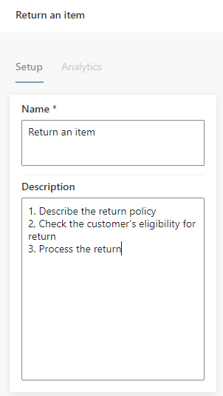
Step 2: Define the goal for the topic
Topic: "Return an item"
Goal:
1. Describe return policy of the store
2. Check customer’s eligibility for return
3. Process the return

Slide 104
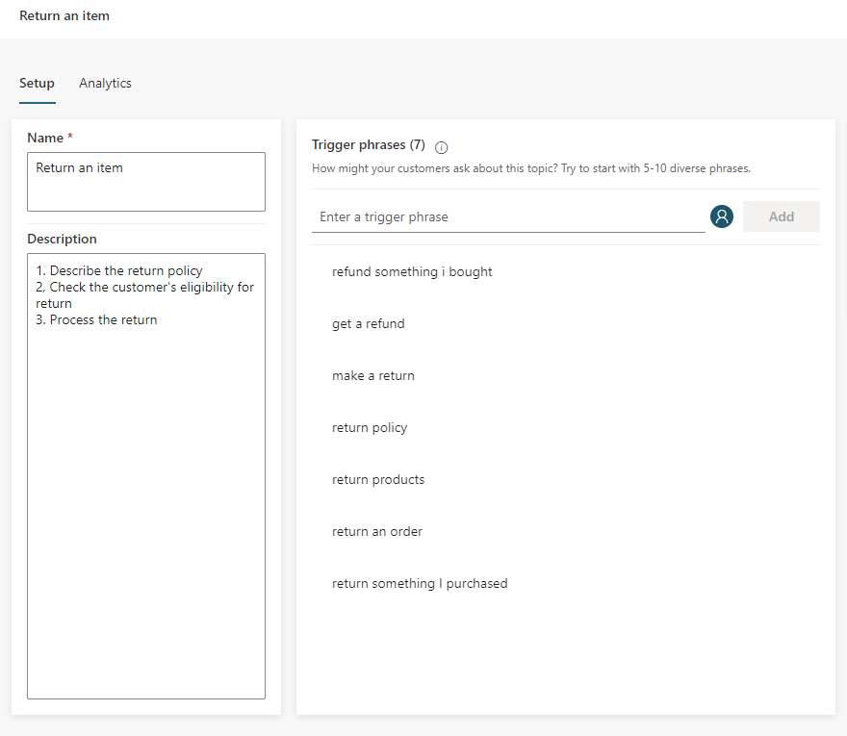
Step 3: Create trigger phrases
Steps:
Start with 5 to 10 trigger phrases. You may need more trigger phrases if the scope of the topic is large
Shorter trigger phrases with less than 10 words are generally better

Slide 105
Step 4: Review trigger phrases 1/3
Steps:
Make sure the trigger phrases are semantically different; using one different noun or verb could be enough to expand a topic’s coverage
Refund something I bought
Get a refund
Make a return
Return policy
Return products
Return an order
Return something I purchased

Slide 106
Step 4: Review trigger phrases 2/3
Adding articles (an, the, etc.), capitalization, contractions, and pluralization has a low chance of improving the triggering
Return some Products
Return Products
Return Product
Return a Product

Slide 107
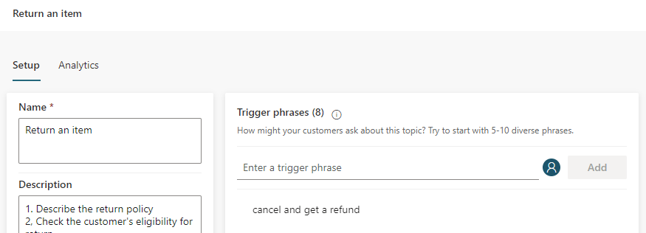
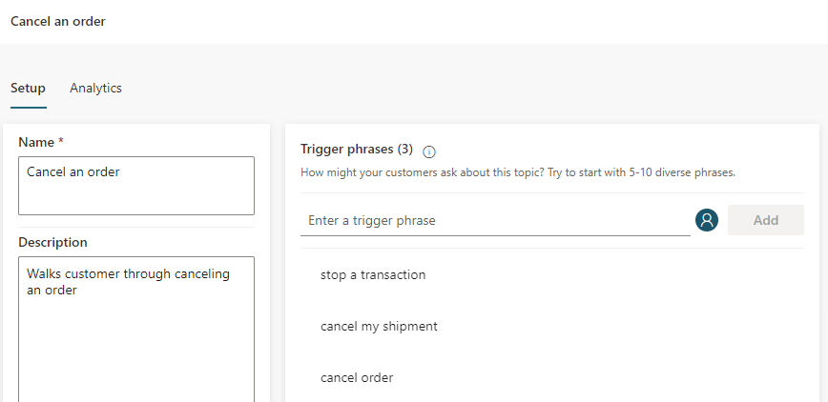
Step 4: Review trigger phrases 3/3
Avoid overlapping trigger phrases or ambiguous trigger phrases among different topics

Slide 108
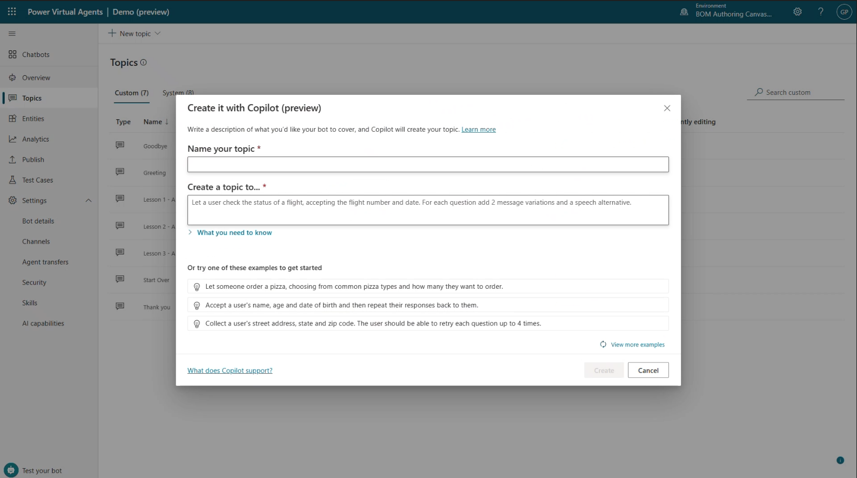
Generative AI
AI assistance in building topics, designing and modifying the copilot all through natural language.
Assisted authoring for:
Topic creation
Topic iteration
Response generation
Adaptive Card generation
Topic improvement suggestions
Suggested trigger phrases, topic names, topic descriptions
Transcript generation
Copilot creation
Topic suggestions
Azure copilots take months to author.
Prompt-authored solutions will take hours, or even minutes to author.
Copilots took days to author.

Slide 109
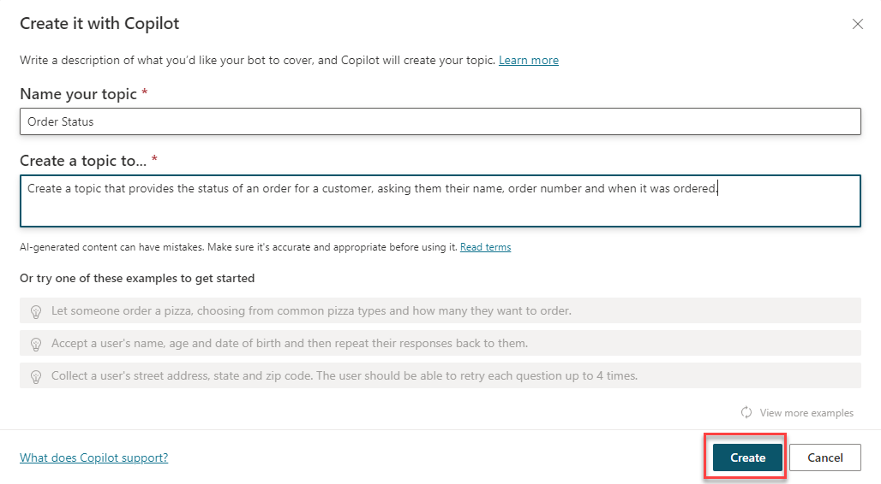
Creating a Topic with Co-Pilot
Create topics using Natural Language to describe what you need the topic to do
Reduce manual steps of creation and iterate using Co-Pilot too!
Notes:
copilot makers can now author a topic in Copilot Studio using natural language to describe what they wish the topic to do and click ‘Create’ for Co-Pilot to automatically build that topic, reducing some of the manual steps you saw in Task 1

Slide 110
Lab 02:
Creating your first copilot
(Lab Time)

Slide 111
Authoring 101 in the Unified Authoring Canvas

Slide 112
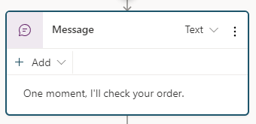
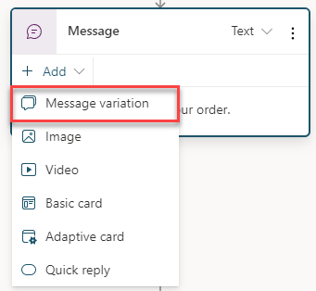
The Message Node
The Message Node is one of the most common nodes used when authoring copilots
It allows you to display standard text, formatted text and dynamic data in the conversation

Slide 113
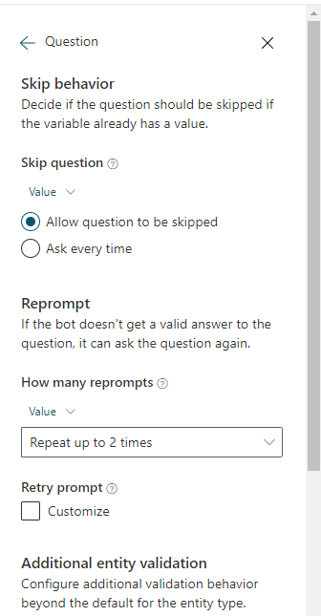
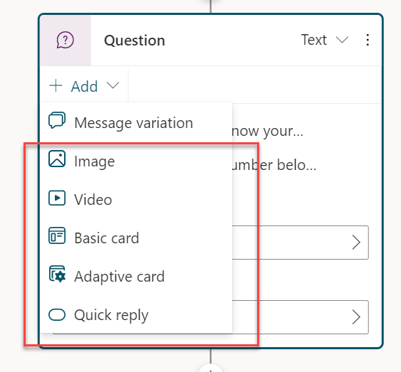
The Question Node
The Question Node is another of the most common nodes used when authoring copilots
It provides capability to ask the user a question and store the data to be used and operated upon

Slide 114

Rich Text Responses
Brand new rich text response options including image and adaptive card
Deliver enhanced experiences to customers and users which are more engaging and display data in more dynamic ways
Notes:
Image you can add an image which will be displayed on the card. Add the URL of the image and optionally a title.
Video you can add a video URL which needs to be a publicly available MP4 or a youtube video URL
Basic Cards are simple cards that provide adaptive card like visuals however require standard input such as Title, Messages and the ability to add ‘Buttons’ with basic actions.
Adaptive Cards can be added which are platform agnostic cards designed to be flexible to suit the need at the time, including requesting action, displaying information so it is displayed with emphasis on specific information or more. Copilot Studio preview supports Adaptive Cards v.1.3 at the time of writing and currently only informational cards are supported (you cannot use action.submit to return a value).
Quick Replies allow users to select from specific options rather than have to type the response out in text based scenarios. They are optional so a user can still type or speak their own response, and should be used to provide common suggestions or to help give the user ideas on the type of information being asked.

Slide 115

Use variables to navigate customers to tailored content
Direct your customers to content you want them to see
Add variables to keep customer information for later in the conversation
Notes:
Variables let you save responses from your customers in a conversation with your copilot so that you can reuse them later in the conversation.
For example, you can save a customer's name in a variable called UserName. The copilot can then address the customer by name as the conversation continues.
You can use variables to create logical expressions that dynamically route the customer down different conversation paths.
You can create a variable to use in a topic, or a copilot (global) variable to use across topics.
You can also feed variables to Power Automate and Bot Framework Skills as input parameters, and save the output results from those actions.

Slide 116

Entities and Slot-filling capabilities
Copilots can intelligently avoid repetitive conversations
Enhances your efficiency as a maker
Copilots can guide you to making the best experience
Notes:
The copilot doesn’t follow the dialog script blindly. It intelligently uses all the information it has available to decide when to ask questions and when to skip them.
For example, if the user provided information earlier in the conversation the copilot will remember that and skip asking about it again.

Slide 117

Topic Management
Re-direct and connect customers to related topics
Use it when:
A conversation requires more than one topic, such as when you need to ask a clarifying question to determine which topic the user needs
Notes:
Go to another topic: This node has an extended flyout menu where you can then go to another topic which needs to be selected
End current topic: This ends the current topic and it is used where the topic was called from another topic, from which it would be returned to where it was originally called from. This can also be used in branching conditions. If this is used to end an entire topic of branch, the behavior will operate like ‘End all topics’ below.
End all topics: End all active topics and the next message from the user will be as a new conversation, and the copilot will trigger the most appropriate topic based on that user message, starting a new active topic.
Transfer Conversation is used to transfer to an agent and send a contextual message. (Not Supported in Preview)
Clear all variables clears all variable values. This is important if you want to begin or loop back into the same topic but take new values, especially if you have configured question behavior properties where a question could be skipped if it already had a value.
Go to Step allows a copilot author to navigate to another node in the open topic. This is great for looping scenarios or if you want to gather more information from the user.
End Conversation confirms the customer has their query answered and would be a natural end to a conversation.

Slide 118


Use enhanced speech authoring capabilities
Directly add SSML overrides
Enhances speech enabled text copilots
Tailor the best experience for your customers
Notes:
The copilot doesn’t follow the dialog script blindly. It intelligently uses all the information it has available to decide when to ask questions and when to skip them.
For example, if the user provided information earlier in the conversation the copilot will remember that and skip asking about it again.

Slide 119

Productivity and Pro Code Options
Author copilots faster with productivity options including copy and paste
Use the code view to quickly code message content
Modify anywhere dialog flow without disruption
Notes:
The copilot doesn’t follow the dialog script blindly. It intelligently uses all the information it has available to decide when to ask questions and when to skip them.
For example, if the user provided information earlier in the conversation the copilot will remember that and skip asking about it again.

Slide 120
Lab 03:
Authoring 101 in the Unified Canvas
(Lab Time)

Slide 121
Copilot Studio + Power Automate

Slide 122


Microsoft Power Automate is an online workflow service that automates actions across
apps and services
Notes:
Power Automate is a SaaS services that helps you work smarter by automating workflow across you’re a growing number apps and services that business users rely on.
The possible workflows span across a wide variety of possibilities, for example :
Get a notifications when a certain file is updated
Synchronize files by connecting your folders to keep data current,
Automatically collect and organize your business data
Streamline approvals and get instant alerts.
Power Automate makes it possible to automate all of these scenarios and more.

Slide 123

Connectivity & integration
Built-in connectivity to
1000+ SaaS cloud services
File providers
Databases
Web APIs
Productivity apps, etc.
Connect to on-premises systems via Data Gateway
Pluggable extensibility via Custom Connectors to integrate existing LOB systems into Power Automate
Notes:
As part of the Copilot Studio license you get access to Power Automate. You will get access to over 450 premium connectors, which allow you to connect to third party services in a low-code graphical interface.
You can connect to any third-party service that Power Automate supports. You can read and write data from the database and you can pass data back and forth between the copilot and Power Automate flow. You also have access to a very convenient HTTP connector in Power Automate which allows you to use your copilot invoke any third-party API that you might have.
With the UI based flow connector in Copilot Studio, you can create flows in Power Automate just for your copilot and invoke them seamlessly from Copilot Studio.

Slide 124
A service for automating workflows across apps and services
CONNECT
to data & systems you’re already using, and create the data you need
CREATE
workflows using triggers & actions without code or scripts
EDIT
flows on web and mobile
APPROVE
requests or manage them on web and mobile

Slide 125



Get started with a growing library of templates
Jumpstart flows using over 100+ templates for common scenarios
Connect services you're already using in more meaningful ways
Notes:
Power Automate has a huge range of templates, which provide you a quick way to get started with commonly used flows and automations, and are also a great way to learn.

Slide 126








Microsoft Power Platform
The low-code platform that spans Office 365, Azure, Dynamics 365, and standalone applications
Innovation anywhere. Unlocks value everywhere.
Power BI
Business analytics
Power Apps
Application development
Power Pages
Secure business websites
Power Automate
Process automation
Copilot Studio
Intelligent Copilots
Canvas Apps
Cloud Flows & Teams Flows
Model-driven Apps
Business Process Flows
Desktop Flows
Data connectors
AI Builder
Dataverse
Notes:
Power Automate is powered by Microsoft Dataverse. Dataverse lets you securely store and manage data that's used by business applications.

Slide 127
Unlock your imagination with Power Automate + Copilot Studio
Copilot Studio uses location-based services (LBS) to provide personalized services
2-factor authentications to increase security
Proactively recommends new promotions, benefits, and better rates to your customers
Check user eligibility and submit applications on their behalf
Remote diagnosis for IOT devices
Make appointments for your customers
Get a picture of the receipt from employee and use Azure AI for expense reimbursement (integration with Azure AI)
Notes:
Using Copilot Studio with Power Automate means your copilot can do far more than just answer questions – it can take action on behalf of the customer. This can also include working with user authentication tokens, as we will see in the next section.
These are just some of the examples of the huge range of scenarios and use cases that can be enabled by Copilot Studio and Power Automate.

Slide 128


Create a Flow from Copilot Studio
Directly within the Copilot Studio canvas, click ‘Create a flow’
Power Automate opens and creates the input and output to pass data
Add your own custom logic in between to configure it to meet your needs

Slide 129

Manage the return of data in Copilot Studio from Power Automate
Specify which variables to send to Power Automate within Copilot Studio
Save data from Power Automate into Copilot Studio variables
Use those variables to perform conditional logic, calculations or display them to the user
Notes:
The bot doesn’t follow the dialog script blindly. It intelligently uses all the information it has available to decide when to ask questions and when to skip them.
For example, if the user provided information earlier in the conversation the copilot will remember that and skip asking about it again.

Slide 130
Lab 04:
Build a Power Automate flow
(Lab Time)

